Slide 1
Best Practices for Serving Imigrant Crime Victims: Law Enforcement, Prosecution, and Protection Orders
Peoria, Illinois
November 2, 2017
National Immigrant Women's Advocacy Project at the American University Washington College of Law

Slide 2
This project was supported by Grant No. 2014-TA-AX-K030 awarded by the Office on Violence Against Women, U.S. Department of Justice. The opinions, findings, conclusions and recommendations expressed in this publication are those of the author and do not necessarily reflect the view of the Department of Justice, Office on Violence Against Wome
National Immigrant Women's Advocacy Project at the American University Washington College of Law

Slide 3
USB Drive Materials
U Visa Toolkit For Law Enforcement Agencies And Prosecutors
DHS: U and T Visa Law Enforcement Resource Guide
DHS: Policies including victim-witness
Tools for officers to promote language access
Bluecard Tool Screening Victims for Immigration Protections

Slide 4
General Caveats
Women, men and children can qualify for U Visas
Victims of almost all violent crimes, and many other crimes are eligible to apply for U Visas
That said, many examples that will be used throughout this presentation will refer to female victims of domestic violence and/or sexual assault
National Immigrant Women's Advocacy Project at the American University Washington College of Law

Slide 5

Participant Introductions,
Goals and Expectations
National Immigrant Women's Advocacy Project at the American University Washington College of Law
Notes:
PRE ASSESSMENT – EVALUTATION

Slide 6
Learning Objectives
By the end of this workshop, you will be able to:
Understand how investigations can be improved by using language access tools
Hold offenders more accountable by using the U Visa certification process as a crime fighting tool
Enhance victim safety and participation in the criminal justice system
Enhance officer/victim/community safety using language access and certification programs
National Immigrant Women's Advocacy Project at the American University Washington College of Law
Notes:
Also, have LEO presenter insert how this will keep THEM safer as well.

Slide 7
How Best Practices in Domestic Violence Investigations Promote Officer Safety

Slide 8
Congress enacted VAWA self-petitioning (1994) and the U and T visas (2000) to:
Purpose of Crime Victim Protections
Improve community policing and community relationships
Increase prosecution of perpetrators of crimes against immigrant victims
Allow victims to report crimes without fear of deportation
Enhance victim safety
Keep communities safe
National Immigrant Women's Advocacy Project at the American University Washington College of Law
8
8
8

Slide 9
PROTECTIONS FOR IMMIGRANT VICTIMS
CONSIDERATIONS
If approved, benefit provides:
Up to four years of temporary nonimmi- grant status
Work authorization
Federal social services benefits
Ability to apply for permanent status
CONSIDERATIONS
Perpetrator must be US citizen or Lawful Permanent Resident spouse or parent or US citizen adult son or daughter
Must be in the US on account of
the trafficking
Law enforcement certification is encouraged but not required
If approved, benefit provides:
Protection from removal
Work authorization
Ability to apply for permanent status
To apply:
USCIS
Form I-914
To apply:
USCIS
Form I-360
T VISA
For victims
of trafficking
VAWA
For victims
of Domestic Violence married to US citizens or permanent residents
CONSIDERATIONS
Qualifying crime must be in the US or have violated US law
Must have law enforcement certification
CONSIDERATIONS
Must fear persecution on account of race, religion, nationality, political opinion, or membership in particular social group
To apply:
USCIS
Form I-918
ASYLUM
For victims of
persecution
To apply:
USCIS or
Immigration Judge
U VISA
If approved, benefit provides:
Up to four years of temporary nonimmigrant status
Work authorization
Ability to apply for permanent status
For victims of Domes- tic Violence, Sexual Assault, Felonious Assault, Trafficking, Other Serious Crimes
If approved, benefit provides:
Asylee status
Work authorization
Federal social services benefits
Ability to apply for permanent status
Form I-589
SIJS
Special
Immigrant Juvenile Status for child victims
CONTINUED PRESENCE
For victims of trafficking
To apply:
CONSIDERATIONS
Victims of a severe form of human trafficking and who may be potential witnesses, or filed a civil action
Law enforcement support is required
CONSIDERATIONS
MMuusstt hhaavvee jjuuvveenniillee ccoouurrtt oorrddeerr
For victims of abuse, abandon- ment, or neglect by one or both parents
To apply:
USCIS
Form I-360
ICE - Federal law enforcement must seek this protection for you
If approved, benefit provides:
Protection from removal
Work authorization
Ability to apply for permanent status
If approved, benefit provides:
Protection from removal designation may be granted initially for a period of 2 years and renewed in increments of up to 2 years
Work authorization
Access to federal social services benefits
DHS.GOV/BLUE-CAMPAIGN
For victim support call 1-888-373-7888 or text INFO or HELP to BeFree (233733)
Notes:
Leslye

Slide 10
Major Forms of Relief
VAWA self-petition
  Abuse by US citizen or lawful permanent
    Spouse, former spouse, parent, step-parent, over 21year old child
Special Immigrant Juvenile Status
  Immigrant children abused, abandoned or neglected by one of their parents
    (US or Abroad)
U Visa
T Visa

Slide 11
DYNAMICS OF DOMESTIC VIOLENCE EXPERIENCED BY BATTERED IMMIGRANTS
Notes:
Leslye

Slide 12


Department of Homeland Security

Slide 13
Immigration Related Abuse
  Refusal to file immigration papers on spouse/child/parent’s behalf
  Threats or taking steps to withdraw an immigration case filed on the survivor’s behalf
    Family or work based visas
  Forcing survivor to work with false documents
  Threats/attempts to have her deported
  Calls to DHS to turn her in – have her case denied
13
Notes:
Leslye

Slide 14
Coercive Control Over
Immigration Status
Among abusive spouses who could have filed legal immigration papers for survivors:
  72.3% never file immigration papers
  The 27.7% who did file had a mean delay of 3.97 years.
65% of immigrant survivors report some form of immigration related abuse (NIJ, 2003)
*Edna Erez and Nawal Ammar, Violence Against Immigrant Women and Systemic Responses: An Exploratory Study (2003)
14
Notes:
Leslye

Slide 15
Connection Between Abuse and Control Over Immigration Status
Abuse rates among immigrant women
  Lifetime as high as 49.8%
  Those married to citizens and lawful permanent residents – 50.8%
  U.S. citizen spouse/ former spouse abuse rate rises to 59.5%
Almost three times the national average
15

Slide 16
What barriers and fears prevent immigrant victims from reporting crime?
National Immigrant Women's Advocacy Project at the American University Washington College of Law
Notes:
I included an umbrella question to emphasize that reporting is ALWAYS hard and even harder for immigrants. I’m trying to build in some sympathy for immigrant communities that may not necessarily be there automatically with our audience.

Slide 17
If they report…
They will be deported
Offender will retaliate
    Harm them
    Harm family members, children
Nothing will happen
Cannot communicate with officers
National Immigrant Women's Advocacy Project at the American University Washington College of Law
Notes:
Instructor’s Note: The point here is that they could have fear of all three outcomes and that it is not as simple as one may think. There needs to be an understanding that there are more barriers to reporting. I DO NOT INCLUDE THE OFFENDER BEING DEPORTED IT IS TOO COMPLEX AN ISSUE AND RESEARCH HAS FOUND THAT FOR MANY IMMIGRANT WOMEN THEY FEAR THAT IF HE IS DEPORTED SHE WILL HAVE TO GO WITH HIM IT THINK WE DO NOT RAISE THIS IN AN OFFICER TRAINING

Slide 18
Fears & Misconceptions
Do not trust police/prosecutors
Economic survival
Pressures from both families
Fear of abandoning the home/community
Fear of losing children
Religious factors
Fear of unknown
Fear of deportation
Dangers in the home country
  Retaliation
  Ostracism
  Police
  Political instability
  Gender barriers
National Immigrant Women's Advocacy Project at the American University Washington College of Law

Slide 19
Major Challenges in working with Immigrant Victims of Crime
Fear of Deportation
Language
Lack of knowledge of legal rights
Do not trust that police/prosecutors will help them
Lack of reporting and/or cooperation as the case moves forward
National Immigrant Women's Advocacy Project at the American University Washington College of Law
14
Notes:
Instructor: Can we agree that these are two (2) of the major issues??? I ADDED A MORE ROBUST LIST THIS NEEDS TO BE A TEACH BACK SLIDE WITH THE TOP ISSUES

Slide 20
Language Access
Best Practices to successfully investigate and prosecute cases involving non-English speaking victims
National Immigrant Women's Advocacy Project at the American University Washington College of Law
Notes:
Instructor: Let’s start with the simpler one first ☺

Slide 21
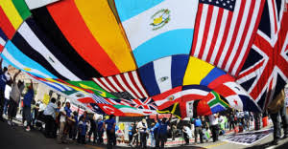
What Countries Do immigrants in your jurisdiction come from?

Slide 22
Rafaela replace the following two slides with Illinois information

Slide 23
Maryland Demographics (2015)*
Total foreign born population – 911,582
15.2% of the state’s 6 million people is foreign born
    49.1% naturalized citizens
    ~27.7% undocumented
    (http://www.migrationpolicy.org/data/unauthorized-immigrant-population/state/MD)
75.9 % rise in immigrant population from 2000 to 2015
28.2% of children in the state under age 18 have 1 or more immigrant parents
    88.7% of children with immigrant parents in the state are U.S. citizens
*Source: http://www.migrationpolicy.org/data/state-profiles/state/demographics/MD
(Oct. 2017)
23

Slide 24
Maryland– Countries/Regions of Origin and Limited English Proficiency (2015)*
Asia – 33.4%
  India (7.0%)
  China (6.1%)
  Philippines (4.0%)
  Korea (3.9%)
  Vietnam (2.3%)
Africa – 16.6%
Latin America – 39.3%
  El Salvador (13.2%)
  Other Central America (7.1%)
  Mexico (4.5%)
Europe – 9.3%
  Germany (1.5%)
  United Kingdom (1.5%)
Canada 1.0%
Limited English Proficiency
(Speak English less than very well)
  Naturalized citizens 26%
  Non-citizens 47%
  Source: http://www.migrationpolicy.org/programs/data-hub/us-immigration-trends#lep (Oct. 2017)
*Source: http://www.migrationinformation.org/datahub/state.cfm?ID=MD
(Oct. 2017)

Slide 25
Source of Language Access Laws
Title VI- No person in the United States shall, on the ground of race, color, or national origin, be excluded from participation in, be denied benefits of, or be subjected to discrimination under any program or activity receiving financial aid assistance.
LEP Executive Order 13166 (2001)
  Requires all agencies receiving any federal financial
  assistance to
  Ensure meaningful language access
  Develop and implement language access plans
  “Where the denial or delay of access may have life or death
  or other serious implications, the importance of the full
  and effective delivery of LEP services is at its zenith.”

Slide 26
  DOJ Model Guidance
Police provide free language access to:
  LEP persons who request it
  When officer decides it is helpful to the criminal investigation or prosecution
Police will inform members of the public that language assistance is available free of charge
Language access provided in persons primary language
  DOJ Sample Policy Center City Police Department
  DOJ Approach to language access outline in:
  Steps for Obtaining Interpreters
National Immigrant Women's Advocacy Project at the American University Washington College of Law
20

Slide 27
First Responders –
What do you do when you arrive at a crime scene?
National Immigrant Women's Advocacy Project at the American University Washington College of Law
Notes:
Open Discussion
This question was a bit confusing at the Miami training – I tried different language

Slide 28

First Response
Locate and secure the scene
Are there any weapons?
Is anyone injured?
Identify the people involved
  Victim
  Offender
  Witnesses
If offender is not on the scene
  Where is the suspect?
  Are they a continuing danger?
  Is suspect in possession of weapon?
National Immigrant Women's Advocacy Project at the American University Washington College of Law
Notes:
Instructor Note: (play 911 recording with LEP person- Mike Seattle or Ana Orlando) GOOD IDEA LETS FIND THIS

Slide 29
What do you do when the people at the scene are limited English proficient?
How can you get the information you need to secure the scene?
National Immigrant Women's Advocacy Project at the American University Washington College of Law

Slide 30
DOJ and Exigent Circumstances
Use the most reliable temporary interpreter available to address exigent circumstances
  Fleeing suspect
  Weapons
  Life threatening to the officer /victim/or public

Slide 31
DOJ Requirements for Investigations & Interrogations
“A qualified interpreter shall be used for any interrogation or taking of a formal statement where the suspect or witness’ legal rights could be adversely impacted”
  Criminal interrogations
  Crime witness interviews
Vital written materials translated into primary language
  Miranda warnings
National Immigrant Women's Advocacy Project at the American University Washington College of Law

Slide 32
Using Qualified Interpreters
Benefits
Safety
ID offender
Locate weapons
Admissible statements (Excited Utterances)
Harms
Mistaken ID of offender
Arrest of victim
Misinterpretation results in inaccurate statements
Trauma to children
National Immigrant Women's Advocacy Project at the American University Washington College of Law
Notes:
Jane: a note for you when you are part of the faculty- you can jump in here to make a quick note that the statements gathered at this point are important to prosecutors- “whatever choices you make here are what the prosecutor is limited to using” and that you will review those later in the training. Also, Jane and Rocio- any suggestions for the title of this slide? How about something like Exigency: What You Do Now Matters Later?- I think the point of this teach back slide is to get the officers rethinking their strategies for dealing with exigent circumstances. I think it might be worth adding notes for the faculty on examples they should discuss in the notes section of the powerpoint.

Slide 33
How does your investigation proceed with an non-English speaking victim?

Slide 34

Language Resources
Language Line
Department interpreters line developed in response to large local refugee population
Immigrant community based organization partners
Health care providers
School systems
National Immigrant Women's Advocacy Project at the American University Washington College of Law
Notes:
LEO NOTE- I will clarify the third bullet with Leslye
May want to use Tony’s FBI video for the language line LETS LOOK AT USING A PART OF THE FBI VIDEO HERE HOW LONG IS IT

Slide 35
Bilingual Officer v. Interpreter
  Bilingual officers
    When they are interpreting, they are not investigating
  Biculturalism v. bilingualism
    Different words have different meanings:
      e.g.: Variations on the word “highway” depending on what state you’re from.
Notes:
Instructor Note: Bilingual officers: use Shelli’s example on murder case http://www.idahopress.com/news/prosecutors-new-evidence-in-nampa-baby-s-death-merits-murder/article_7c9d0be9-78f1-598a-99cf-662b048630b6.html) and Prosecutor’s examples of how cases can go awry
instructor Note: Biculturalism v. bilingualism: it should be an officer that is familiar with the cultural issues
Instructor Note: highway example: there are different words in English for the word highway depending on what state you live in, so imagine the complexity of interpreting terms of art from English to another language

Slide 36
Tips for Working with Interpreters
Control the interview
Pre-session with the interpreter
  Where are they located?
  Establish what your rules are
    how do you want the interpreter to interpret?
Interpreter has to interpret everything that you say
  Example: when you are explaining confidentiality
National Immigrant Women's Advocacy Project at the American University Washington College of Law

Slide 37
Red Flags
Can you understand the interpreter?
Does the LEP person look confused?
Does the interpreter appear confused?
Is the interpreter engaging in side conversations?
Is the interpreter summarizing?
Is everything being interpreted?
Is there a change in the individual’s demeanor?
Are they using English words?

Slide 38
VAWA Confidentiality
Protections

Slide 39
VAWA Confidentiality Prongs
Abuser-Provided Information: DHS, DOJ and the State Department are barred from taking action against a victim based solely upon information provided by abusers and crime perpetrators (and their family members)
Location Prohibitions: Enforcement locational prohibitions unless comply with specific statutory and policy safeguards
Non-Disclosure: Unless one of the enumerated exceptions apply,DHS, DOJ and the State Department cannot disclose VAWA information to anyone
  VAWA self-petitioners, VAWA cancellation/suspension, T visa, U visa, Battered Spouse Waiver, Abused Visa Holder Spouses
Notes:
AMY

Slide 40
VAWA Confidentiality Prongs
Non- Disclosure
Abuser-Provided Information Prohibition
Protects:
All Victims
Requires:
No action at protected locations OR
Notice to Appear must state how they complied with VAWA confidentiality
Location Prohibitions
Protects victims who have filed a protected case with DHS
Includes family members of abusers, crime perpetrators
Protects:
*All victims abused by as spouse or parent
*All victims in the process of applying for U or T visas
*Abused spouses of visa holders with VAWA work authorization filed
Notes:
Leslye

Slide 41
Immigration Options for Immigrant
Crime Victims and Children
(Red = VAWA Confidentiality Protected Case)
VAWA self-petition
  Abused spouses/children of US citizens and lawful permanent residents
  Abused parents of U.S. citizens over 21 years of age
VAWA cancellation of removal
VAWA suspension of deportation
  Abused spouses/children of US citizen and lawful permanent residents protection from deportation
Battered spouse waiver
  Abused spouses of US citizens with two-year conditional permanent residency
U visa
  Has been, is being or is likely to be helpful in the detection, investigation, prosecution, conviction or sentencing
  Substantial harm from criminal activity
T visa and Continued Presence
  Victims of severe forms of human trafficking
Abused Spouse of Visa Holders
  Spouses battered or subjected to extreme cruelty by spouses with the following visas: A(diplomats), E(3)(Austrailian specialty occupation workers), G (foreign gov- Int’l orgs), H (work visas)
Special Immigrant Juvenile (SIJS)
  Children abused, battered, abandoned or neglected by one or both parents
Deferred Action (DACA)
  Deferred action for child arrivals including Dreamers
Asylum
  Well founded fear of persecution on account of race, religion, nationality, political opinion, social group
  Domestic violence as gender based asylum
Notes:
Leslye discusses differences among remedies VAWAs and Us - Benefits + case processing times

Slide 42
DHS VAWA Confidentiality
Computer System
Directs to check for“384” computer system flag that identifies victims who have already filed for or have been granted victim-based immigration relief
Reminds immigration officers, agents, attorneys about immigration law protections for
  Survivors of domestic violence
  Crime victims survivors
  Human trafficking survivor
Notes:
Leslye
Mention that this system is checked when ICE receives detainer requests.

Slide 43
Relying on Information Provided by Abuser
The government cannot gather and/or use information provided solely by:
  A domestic violence or child abuser;
  A sexual assault or stalking perpetrator
  A trafficker;
  The perpetrator of any U visa listed crime
  The perpetrator’s family member
  Other persons associated with the perpetrator
To take an adverse action against a victim
The victim not required to have filed an immigration case to be protected
  All spouse and child abuse victims protected no filing needed
    Includes abused spouses of work visa holders
  Victims in the process of filing T or U visa cases
Notes:
Amy

Slide 44
Adverse Actions Include Using Perpetrator Provided Information To…
Deny a victims immigration case
Detain a victim
Deport a victim
Initiate an immigration enforcement action against a victim
Seek out, question or detain a victim at a prohibited location

Slide 45
When Does VAWA Confidentiality Protection End?
Protections applies from the time of filing permanently unless
  Case denied on the merits and
  All appeal options have been completed
Notes:
Amy

Slide 46
Victims for Which VAWA Confidentiality Will Offer Less Protection
Victims with criminal histories
  Including arrests
Victims with outstanding deportation orders
Victims eligible for VAWA, T or U who have not filed their immigration case

Slide 47
VAWA Confidentiality Violations
Each violation
  Disciplinary action and/or
  $5,000 fine for the individual
Violations also include making a false certifications in a Notice to Appear
VAWA Confidentiality Enforcement Guidance CRCL (2008)
Notes:
Amy

Slide 48
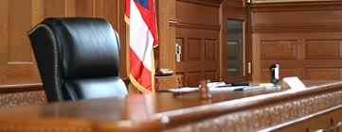
VAWA Confidentiality Violations Effect on Immigration Court Proceedings
Can result in dismissal of the immigration proceeding against the non-citizen (VAWA 2005 legislative history)
Notes:
Leslye

Slide 49
U Visas as a Crime Fighting Tool
Improving the reporting, investigation, and prosecution of violent crime
& keeping everyone safer
National Immigrant Women's Advocacy Project at the American University Washington College of Law
Notes:
Instructor “Moving on to the more complex issue”

Slide 50
What, if anything, do you know about U Visas?
National Immigrant Women's Advocacy Project at the American University Washington College of Law
Notes:
Participants can now fill out the pre assessment in the evaluations.
What is your knowledge of
the U visa?

Slide 51
Overview of the U Visa
What is the U visa?
Purpose: Why does it exist?
National Immigrant Women's Advocacy Project at the American University Washington College of Law
Notes:
Make sure you understand what the U visa is

Slide 52
U Visa Basics
Law enforcement certification is just one part of the overall process it does not = Citizenship
Meant to promote reporting of crime
Targets offenders who prey on most vulnerable victims
Offender may be citizen or non-citizen
Can be “revoked”
Increases immigrant victim participation in criminal justice system
National Immigrant Women's Advocacy Project at the American University Washington College of Law

Slide 53
DHS Video Part 1.mpg
http://niwaplibrary.wcl.american.edu/2014/04/dhs-roll-call-videos/
National Immigrant Women's Advocacy Project at the American University Washington College of Law

Slide 54
U Visa Requirements
Victim of a qualifying criminal activity
Has been, is being, or is likely to be helpful in
  Detection, investigation, prosecution, conviction or sentencing
Suffered substantial physical or mental abuse as a result of the victimization
Possesses information about the crime
Crime occurred in the U.S. or violated U.S. law
54
54
National Immigrant Women's Advocacy Project at the American University Washington College of Law
54

Slide 55
U Visa Criminal Activities
(11/2011 data)
Domestic violence 45.9%
Rape, sexual assault, incest, trafficking 30.4%
Felonious assault, murder, manslaughter 9.9%
Kidnapping, being held hostage, unlawful criminal restraint, torture 8.47%
Blackmail, extortion, perjury, obstruction of justice, attempts, conspiracy, solicitation 5.3%
Notes:
Leslye

Slide 56
Qualifying Criminal Activity
Domestic violence
Sexual assault
Rape
Incest
Prostitution
Torture
Female genital mutilation
Felonious assault
Manslaughter
Murder
Kidnapping
Abduction
Trafficking
Involuntary servitude
Slave trade
Being held hostage
Peonage
Fraud in Foreign Labor Contracting
False Imprisonment
Blackmail
Extortion
Witness tampering
Obstruction of justice
Perjury
Stalking
*Attempt, conspiracy or solicitation to commit any of these crimes any similar activity
National Immigrant Women's Advocacy Project at the American University Washington College of Law
Notes:
Faculty Note: Explain why its Qualifying Criminal activity and NOT CRIME -

Slide 57
Who can apply?
Victims of qualifying criminal activity
Parents and guardians can apply as an “indirect victim” if:
  the victim is a child under 21 years of age and/or
  is incompetent, incapacitated, or deceased due to murder or manslaughter
Bystanders victimization – very limited
For child victims a “next friend” can provide helpfulness
National Immigrant Women's Advocacy Project at the American University Washington College of Law
57
Notes:
Instructor’s note- FOR INDIRECT VICTIM _ The immigration status of the child is irrelevant
Analyze helpfulness of “indirect victim”:
Forensic interview or examination?
Proof of age or disability?
Engaged in services benefiting case?

Slide 58
Who Can Certify?
  “law enforcement” &“law enforcement agencies” =
Federal, state, and local
  Police, sheriffs, FBI, HSI, ATF…
  Prosecutors
  Judges, Magistrates, Commissioners
Departments of Labor (DOL) and the Equal Employment Opportunity Commission (EEOC)
Child and Elder Abuse investigators and agencies
Other government agencies
National Immigrant Women's Advocacy Project at the American University Washington College of Law
Notes:
OTHER = Any government agency that has the authority to detect, investigate, prosecute, convict or sentence based on facts related to criminal activities covered by the U or T visa

Slide 59
U Visa Certification Considerations
What criminal activity occurred?
Identify the victim or indirect victim
  Note injuries observed, if any
Determine helpfulness of the victim
Determine if any family members were implicated in the crime
National Immigrant Women's Advocacy Project at the American University Washington College of Law

Slide 60
Things to Know About Certifying
“Do I believe this person was a victim of a qualifying crime?”
“Did the person assist or willing to assist in detection, investigation, conviction, prosecution and/or sentencing?”
Question is NOT:
  Can we prosecute the crime?
  Can I arrest the offender?
  Do I have proof beyond a reasonable doubt?
  Will the prosecutor’s office file charges?
  Is this within the statute of limitations?
  Did we get a conviction?
National Immigrant Women's Advocacy Project at the American University Washington College of Law

Slide 61
How will a U visa certification request come to you?
From victim advocate or immigration attorney
As a police officer you are the first responder
As a prosecutor you might have continued contact with the victim and might be first to identify victim’s U visa eligibility
National Immigrant Women's Advocacy Project at the American University Washington College of Law

Slide 62
When should you certify?
National Immigrant Women's Advocacy Project at the American University Washington College of Law

Slide 63

Timeline
Certification must be included in the initial application for a U Visa
Once the initial application is processed:
  Victim is entered into a database and flagged as an applicant for a U Visa
Immigration proceedings will not be initiated
Offender can not intimidate with threats
National Immigrant Women's Advocacy Project at the American University Washington College of Law

Slide 64
Certifying early
PROS
Protect from deportation
Protect from offender
CONS
Accusation that victim is lying for immigration benefit
Build rapport
Establish trust
National Immigrant Women's Advocacy Project at the American University Washington College of Law

Slide 65
Beyond the Certification
Brainstorm
In addition to the certification, what else is a victim required to prove to Homeland Security in order to receive a U Visa?
National Immigrant Women's Advocacy Project at the American University Washington College of Law
65
Notes:
Jane’s Note: I WOULD TAKE THIS OUT as it should be covered in the Application slide, however it should probably be mentioned throughout by presenters (reminding audience that they are not making the ultimate decision)

Slide 66
The U Visa Application Process
Certification
Application & Supporting Documentation
Decision by DHS
Typical length of process = 12 -18 months
National Immigrant Women's Advocacy Project at the American University Washington College of Law

Slide 67
DHS Decision
Were they a victim of a qualifying crime?
Did they suffer substantial harm as a result of victimization?
Assess whether the victim unreasonably did not comply with requests from law enforcement (helpfulness)
Is the victim admissible?
    Review of criminal history
    Review of immigration history
National Immigrant Women's Advocacy Project at the American University Washington College of Law
Notes:
Faculty NOTE: Mention that USICS does a fingerprint back ground to check the criminal and immigration history of victims applying.

Slide 68
U-visa Facts and Benefits
Only 10,000 U-visas can be granted annually
  Waitlist approval backlog 62,000 visas
The U-visa grants a temporary 4 year stay
Work authorization ( ≈ 28 months)
Benefits for family members applicants
  Under 21: spouse, children, parents, unmarried siblings under age 18
  Over 21: spouse and children
Lawful permanent residency after 3 years if
  Cooperation or not unreasonably refuse to cooperate
  + humanitarian need, family unity or public interest
U.S. citizenship after 5 years of lawful permanent residency+ proof of good moral character

Slide 69
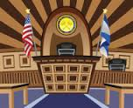
How does law enforcement and prosecution benefit from the U visa?
National Immigrant Women's Advocacy Project at the American University Washington College of Law

Slide 70
U Visa Benefits to Law Enforcement and Prosecutors
Encourages victims to report crimes
Improves investigation and prosecution of violent crimes
Increases potential to convict most dangerous criminals
Demonstrates commitment to protecting immigrant community members
Enhanced immigrant community involvement
Makes it easier to identify victim witnesses
Reduces repeat calls and recanting victims
Fosters community policing partnerships
Enhances Officer and Community Safety
National Immigrant Women's Advocacy Project at the American University Washington College of Law
70
70
Notes:
Instructor Note: Although its discretionary these are the reasons why certification is good police practice

Slide 71
Prosecution Specific Issues
National Immigrant Women's Advocacy Project at the American University Washington College of Law

Slide 72
Discovery
Must provide defense with any materials within the state’s control that may effect the credibility of any witness or that goes to any witnesses motive to lie or bias
  Is it within the State’s control?
  Does it go to the witness’ credibility, bias, or motive to lie?
National Immigrant Women's Advocacy Project at the American University Washington College of Law
Notes:
It is within the State’s control if the police or investigating agency has it – JUST THE CERTIFICATION
“credibility, bias, motive to lie” = BROAD
Possibly something to meet with advocates and immigration attorneys about – either bare bone applications or not providing state with accompanying documentation (except obviously police reports which they have anyway)

Slide 73
#1 Concern:
Explicit or implicit accusation that the victim is lying to stay in the country
National Immigrant Women's Advocacy Project at the American University Washington College of Law
Notes:
OMIT FOR LAW ENFORCEMENT TRAINING ONLY USE WHEN MORE PROSECUTORS ARE IN THE ROOM
Defense is playing to anti-immigrant sentiments, but is also relying on misinformation about the U Visa application process.

Slide 74
Cross-Examination
It goes to the witness’ credibility, bias, or motive to lie – they can be asked about it.
  Discuss during voir dire
  Identify jurors with anti-immigrant attitudes and get them off the jury
  Prepare victim for cross-examination
National Immigrant Women's Advocacy Project at the American University Washington College of Law
Notes:
OMIT FOR LAW ENFORCEMENT TRAINING ONLY USE WHEN MORE PROSECUTORS ARE IN THE ROOM
It is within the State’s control if the police or investigating agency has it – JUST THE CERTIFICATION
“credibility, bias, motive to lie” = BROAD
Possibly something to meet with advocates and immigration attorneys about – either bare bone applications or not providing state with accompanying documentation (except obviously police reports which they have anyway)

Slide 75
Rebuttal Testimony
Once the defendant has alleged that the victim has a motive to lie, the prosecution can introduce the victim’s prior consistent statements about the charged crime
Door to this testimony call be opened at any time, but is likely done during cross-examination
Notes:
Be prepared with case law and a legal brief, if appropriate

Slide 76
Prior Consistent Statements
Non-Hearsay
Not subject to Crawford
Any consistent statement
  offered to rebut an express or implied charge that the declarant recently fabricated it or acted from a recent improper influence or motive in so testifying
  to rehabilitate the declarant's credibility as a witness when attacked on another ground

Slide 77
Introducing Statements
Establish timeline of when victim was told about U Visa and statement made prior to that time
Motive to Lie
Victim statements including 911 call and statements to first responders, friends, family, and advocate
Rebut charge that victim is lying to get U Visa
Use these statements
Notes:
PRESENTER should also get out the fact that these statements are not usually admissible (barring EU / non-testimonial analysis). In my experience, LEOs that have not testified do not know that they cannot testify to what the victim told them – even if it’s a taped statement.

Slide 78
Prior Consistent Statements
Not hearsay if the victim testifies, it is consistent with the victim’s testimony, and is
      a. offered to rebut an express or implied charge that the declarant recently fabricated it or acted from a recent improper influence or motive in so testifying; or
      b. to rehabilitate the declarant's credibility as a witness when attacked on another ground; or
Fed. R. Evid. 801(d)(1)
National Immigrant Women's Advocacy Project at the American University Washington College of Law
Notes:
OMIT FOR LAW ENFORCEMENT TRAINING ONLY USE WHEN MORE PROSECUTORS ARE IN THE ROOM

Slide 79
Victim Statements
911 call
Statements to first responders
Interview by detective
Comments made to family, friends, or coworkers
Conversation with service providers
  Community-based v. Systems-based

Slide 80
Certify Early
PROS
Protect from deportation
Protect from offender
CONS
Accusation that victim is lying for immigration benefit
Build rapport
Establish trust

Slide 81
Going Forward
When probable cause exists, certify early to ensure victim safety and enhance victim participation
Focus on the offender’s actions throughout the investigation and prosecution
For prosecutors: Litigate discovery and pretrial motions to ensure just results
Turn challenges into strengths

Slide 82
Human Trafficking
Generally: use of force, fraud and/or coercion to exploit a person for profit.
Federal statute: TVPA 2000
Maryland law: Md. Code Ann., Crim. Law § 11-303
National Immigrant Women's Advocacy Project at the American University Washington College of Law

Slide 83
What are Severe Forms of Human Trafficking?
Sex Trafficking: in which a commercial sex act is induced by force, fraud, or coercion, or in which the person induced to perform such act has not attained 18 years of age; or
Labor: The recruitment, harboring, transportation, provision, or obtaining of a person for labor or services, through the use of force, fraud, or coercion for the purpose of subjection to involuntary servitude, peonage, debt bondage, or slavery
(Federal Law—“Victims of Trafficking and Violence Prevention Act of 2000 can be found at www.ojp.usdoj.gov/vawo/laws/vawo2000/)
Notes:
83
Tony

Slide 84
Three Elements of Trafficking
1
PROCESS
Recruiting
OR
Harboring
OR
Obtaining a Person
3
END
For the purpose of
Involuntary Servitude
OR
Debt Bondage
OR
Slavery
OR
Sex Trade
2
MEANS
By Force
OR
Fraud
OR
Coercion
Notes:
84
Tony

Slide 85
Continued Presence
Temporary lawful immigration status
  For victims of severe forms of human trafficking
  Victim of human trafficking who is a potential witness in investigation or prosecution of a trafficker
Requested by federal law enforcement
  Can be on behalf of state and local LEAs
  One year, can be renewed
  Can have family members join them

Slide 86
Continued Presence - Benefits
Temporary legal status in the U.S.
Work authorization
Access to public benefits – like refugees
  State and federal
Family members can join
Can travel within the U.S.
Does not lead directly to permanent legal status

Slide 87
T Visa Overview
4 Year Visa
  Victim of Severe form of Trafficking
  In the US or territories on account of trafficking
  Respond to reasonable requests for collaboration with investigation
  Prosecution unless victim is under 18
  Hardship upon return to home country
May apply for lawful permanent residency after investigation/prosecution is over or 3 years, what ever time is shorter
National Immigrant Women's Advocacy Project at the American University Washington College of Law

Slide 88
The T Visa Application Process
Continuous Presence/
*Endorsement
Application & Supporting Documentation
Decision by DHS
Identification
Typical length of process = 4 - 6 months
National Immigrant Women's Advocacy Project at the American University Washington College of Law
Notes:
* ENDORSE MENT IS NOT A REQUIREMENT

Slide 89
T Visa Certification Not Mandatory
T visa certification discretionary
Certification provides helpful evidence
Victim can file for a T visa without a certification

Slide 90
Family Members Who Can Be Included in T Visa Application
Child victims under age 21 can include:
  Spouse, children, parents and unmarried siblings under age 18
Victims over 21 can include:
  Spouse and children

Slide 91
T Visa Benefits
While Case is Pending
  Protection from deportation and removal
  VAWA Confidentiality
  Programs and services necessary to protect life and safety
Upon receiving a bona fide determination or continued presence
  All federal and state public benefits
  Health Care Exchanges
  Receives work authorization
  Drivers licenses
Upon Approval
  Immigration benefits for children (and unmarried siblings if applicant is under age 21)
  Eligible for lawful permanent residence after 3 years
  Can travel outside of the U.S. but may need permission

Slide 92

Helpfulness
By the end of this segment, you will be able to:
Understand the scope of the helpfulness standard
Apply the helpfulness standard to U visa certifications
National Immigrant Women's Advocacy Project at the American University Washington College of Law
92

Slide 93
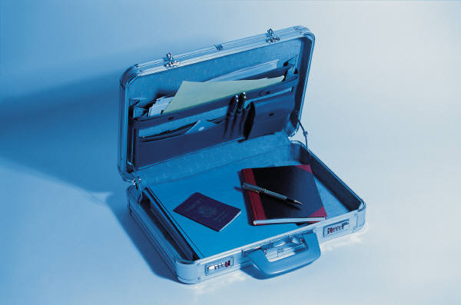
Hypotheticals
Small Group Activity
Is this person eligible for a U Visa certification?
Stories handout
National Immigrant Women's Advocacy Project at the American University Washington College of Law
Notes:
Get additional scenarios that involve crimes other than DV/SA
Shelli and Stacey- financial crimes

Slide 94
Helpfulness in the Regulations
Statute and DHS Regulations: has been helpful, is being helpful or is likely to be helpful in the
      Detection, or Investigation, or
      Prosecution, or Conviction or
      Sentencing
There is no degree of helpfulness required
Law enforcement may complete U visa certification once they assess victim’s helpfulness
The investigation or prosecution can still be ongoing
National Immigrant Women's Advocacy Project at the American University Washington College of Law

Slide 95
Helpfulness can be satisfied even if:
Victim reports a crime where there’s no further investigation
Report is of past crime that the victim did not report at the time
Perpetrator absconds or is subject to immigration removal
The perpetrator is being prosecuted for a different crime
Victim is not needed as a witness
Victim is dead (indirect victim qualifies)
Perpetrator is dead
Victim has a criminal history or is subject to immigration enforcement
Victim fully discloses story after better understanding rights, the U-visa and meaningful language access
National Immigrant Women's Advocacy Project at the American University Washington College of Law

Slide 96

What does it mean for a victim to “unreasonably refuse” to provide assistance?
National Immigrant Women's Advocacy Project at the American University Washington College of Law

Slide 97
Why would a victim report a crime and then refuse to participate in the ensuing investigation and trial?
National Immigrant Women's Advocacy Project at the American University Washington College of Law

Slide 98
Reasons for Refusing to Cooperate
Fear of reprisal
Continued threats or violence
Pressure from either family
Financial hardship
Lesser of two evils
National Immigrant Women's Advocacy Project at the American University Washington College of Law
Notes:
Instructor Note: NEED to flush this out

Slide 99
Evaluating Whether Victim’s Refusal to
Provide Assistance/Cooperation was “Unreasonable”
Considerations:
  totality of the circumstances, including the nature of the victimization
  victim’s fear or the abuser
  trauma suffered
  force, fraud or coercion
National Immigrant Women's Advocacy Project at the American University Washington College of Law

Slide 100
Witness Tampering
Detect signs of witness tampering
  Change in frequency of contact
  Missed appointments
  Recantation or minimization
Investigate
  Follow up with victim
  Contact victim advocate, immigration attorney, others that had contact with victim
  Jail calls
  Interview friends, neighbors, and family
National Immigrant Women's Advocacy Project at the American University Washington College of Law
Notes:
Depending if we decide to move the “unreasonably refuse” slides, we can put it after this section.

Slide 101
If you still believe the victim is unreasonably refusing…
Note on the certification, sign, and return to victim or victim’s attorney
Burden shifts to victim to prove the refusal is not unreasonable
DHS makes the ultimate decision
National Immigrant Women's Advocacy Project at the American University Washington College of Law
101

Slide 102
DHS Video Part 2.mpg http://niwaplibrary.wcl.american.edu/2014/04/dhs-roll-call-videos/
National Immigrant Women's Advocacy Project at the American University Washington College of Law
Notes:
Most important part is Scott’s part about USCIS credibility and fraud check
http://niwaplibrary.wcl.american.edu/2014/04/dhs-roll-call-videos/

Slide 103
U-visa Application Victim Flow Chart
Criminal activity
occurs.
IF: The victim has been helpful, is being helpful, or is likely to be helpful to law enforcement
OR
The victim is under 16 years of age and victim’s parent, guardian, or next friend has been helpful, is being helpful, or is likely to be helpful to law enforcement
OR
The victim is 21 years of age or older and is deceased due to the criminal activity, incapacitated, or incompetent;
the spouse and/or children under 21 of the victim have been helpful, are being helpful or are likely to be helpful to law enforcement
OR
The victim is under 21 years of age and is deceased due to the criminal activity, incapacitated, or incompetent;
the victim’s spouse, children, parents, or unmarried siblings under 18 have been helpful, are being helpful or are likely to be helpful to law enforcement
THEN
Victim (or legal representative) seeks I-918B, Law Enforcement Certification.
(if victim is not working with a service provider, law enforcement officers can refer victims at this point.)
Victim submits U-visa application to the Victims and Trafficking Unit of USCIS showing that the victim meets each of the U-visa eligibility requirements.
The application includes*:
U visa application form – Form I-918
Law Enforcement Certification – Form I-918, Supplement B
Documents related to victim’s identification
Victim’s signed statement describing the facts of the victimization
Any information related to victim’s criminal history, including arrests
Any information related to victim’s immigration history, including prior deportation
Any information related to victims health problems, use of public benefits, participation in activities that may pose national security concerns, and moral turpitude
Any information related to the victim’s substantial physical or mental abuse suffered
Other documentation such as police reports, medical records, letters of support from service providers.
Eligible family members can also apply.
* Other administrative documentation is also required. More information is available at www.legalmomentum.org.
Law Enforcement provides victims with:
1. I-918 Law Enforcement Certification signed in blue ink and completed by
  a. the head of the certifying agency; OR
  b. a person in a supervisory role specifically designated by the head of the agency to sign certifications
2. Any supporting documentation such as reports and findings; and
3. In the case of 1b) a letter from the head of the agency designating another person to sign the certification (designee letter).
Within about 9 months, victim receives
decision on U-visa application. If approved,
victim receives work permit. If applications
for family members are approved and they are
abroad, consular processing begins.
After 3 years, U-visa holders (victims) apply for lawful permanent residence (“green card”)
The application includes:
Adjustment of Status Application- Form I-485
Any information related to the victim’s continuous presence in the U.S. since obtaining U-visa status
Any information indicating that USCIS should
exercise its discretion to grant lawful permanent residence
Any information indicating that the U-visa holder has not unreasonably refused to cooperate with an ongoing investigation or prosecution
Eligible family members can also apply.
Within about 1 month, victim receives receipt notice from USCIS
confirming filing
of U-visa application.
Prepared by the National Immigrant Victims Access to Justice Partnership (2010). This project was supported by Grant No. 2009-DG-BX-K018 awarded by the Bureau of Justice Assistance. The Bureau of Justice Assistance is a component of the Office of Justice Programs, which also includes the Bureau of Justice Statistics, the National Institute of Justice, the Office of Juvenile Justice and Delinquency Prevention, the SMART Office, and the Office for Victims of Crime. Points of view or opinions in this document are those of the author and do not represent the official position or policies of the United States Department of Justice.
Notes:
103

Slide 104
Law Enforcement provides victims with:
1. I-918 Law Enforcement Certification signed in blue ink and completed by:
  a. the head of the certifying agency; OR
  b. a person in a supervisory role specifically designated by the head of the agency to sign certifications
2. Any supporting documentation such as reports and findings; and
3. In the case of 1b) a letter from the head of the agency designating another person to sign the certification (designee letter).
National Immigrant Women's Advocacy Project at the American University Washington College of Law

Slide 105
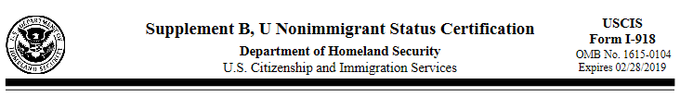
U Visa Certification Overview
National Immigrant Women's Advocacy Project at the American University Washington College of Law

Slide 106
Review the U Visa Certification Form
Located in your training packet
Goals: Identify the criminal activity and the victim, then begin the certification process
National Immigrant Women's Advocacy Project at the American University Washington College of Law

Slide 107
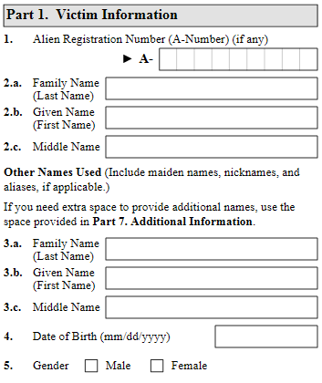

This is sometimes filled out by the victim’s immigration attorney or advocate. (Certifier Preference)

Slide 108
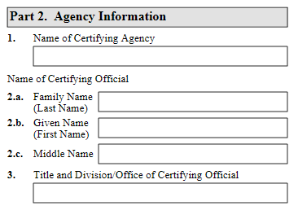
In addition to the head of the agency, one or more certifying officials can be designated as a “Certifying Official”
National Immigrant Women's Advocacy Project at the American University Washington College of Law

Slide 109
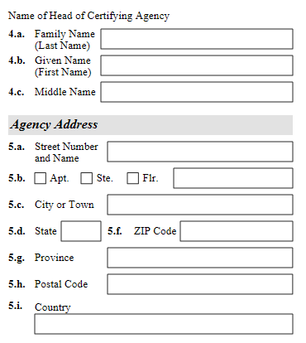

Slide 110
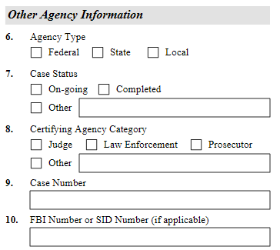

Slide 111
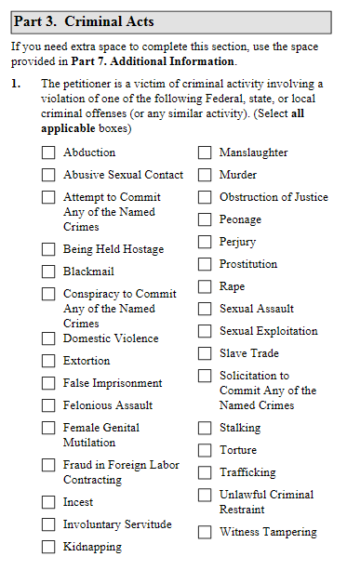
You can & should certify multiple offenses when present.
National Immigrant Women's Advocacy Project at the American University Washington College of Law

Slide 112
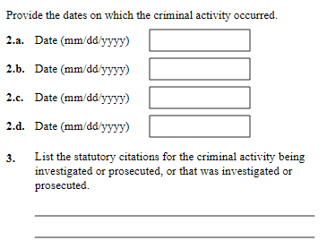
Dates do not have to be precise – you can use months, seasons or years.
National Immigrant Women's Advocacy Project at the American University Washington College of Law

Slide 113
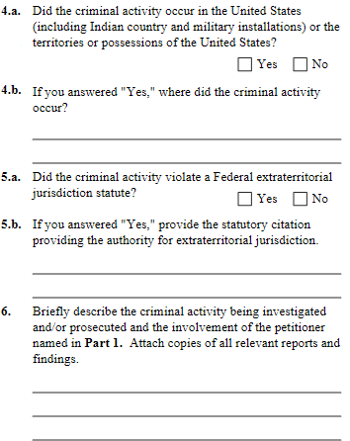
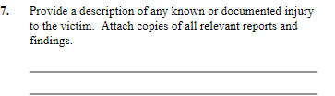
Make copies of all reports and attach.
Be as specific as possible, highlighting visible injuries observed (even if not photographed).
If you are aware of mental injury, include as well.

Slide 114
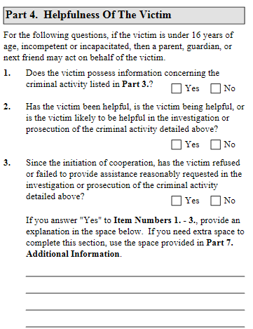

NOTE: This will be discussed in detail in the next section
National Immigrant Women's Advocacy Project at the American University Washington College of Law

Slide 115
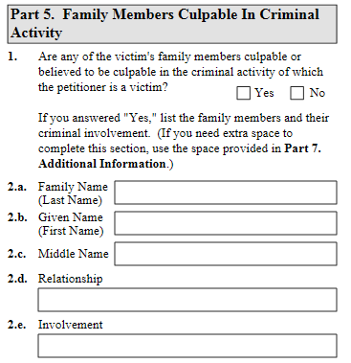
Because many applications will include domestic violence, this may likely be the defendant.
National Immigrant Women's Advocacy Project at the American University Washington College of Law

Slide 116
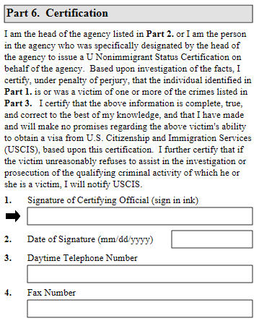
REMEMBER: This is merely a certification that you believe they were a victim of a crime. This does not automatically mean that the victim will be granted immigration relief.
National Immigrant Women's Advocacy Project at the American University Washington College of Law

Slide 117
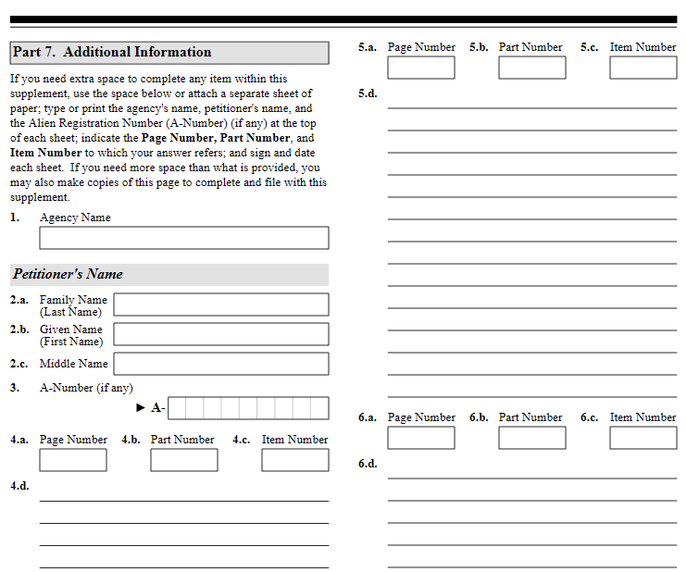

Slide 118
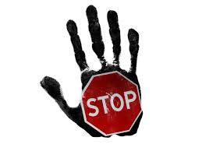
Protection orders
Notes:
Leslye

Slide 119
NIJ Funded CPO Study Found
With support immigrant victims will use and benefit from justice system assistance
  60.9% did not know about CPOs
  81% got CPO with help from advocate/attorney
  96% found them helpful
  68.3% of violations immigrant related

Slide 120
Protection Orders
All persons are eligible to receive civil protection orders without regard to the immigration status of any party or child
Protection order issuance = no effect on immigration status
A conviction or finding of violation of the “protection against abuse provisions” of a protection order is a deportable offense
Notes:
Loretta

Slide 121
Essential Remedies
Address remedies needed to
  Stop abuse
  Address housing
  Custody of children and visitation
Immigrant victims and their children often need creative protection order remedies using the state catch all provisions

Slide 122
Creative Protection Order Remedies
Catch all provisions in civil protection order statues opportunity to offer relief designed to help:
  Curb future abuse, harassment
  Interfere with abuser/perpetrators ability to exert power and/or coercive control
  Offer victim remedy-relief for past abuse
  Help victim overcome victimization and build new post abuse life
Nexus With Victimization
Opportunity for courts to counter immigration related abuse and order culturally helpful remedies

Slide 123
Creative Remedies:
Small Group Activity
What creative protection order remedies might help an immigrant victim?

Slide 124
Use Creative Remedies to…
Stop immigration related abuse
Protect victims still living with their abusers
Obtain documents the victim needs for an immigration case or for care of child
Deter parental kidnapping
Child/Spousal support
  Affidavit of support
Health insurance
Notes:
Loretta

Slide 125
Victims Who Stay:
Full Contact Protection Orders
No state’s protection order statute requires separation of the parties
In virtually every state victims cannot violate their own protection orders
  Contrary to statutory intentions; and
  Against public policy to prosecute abused women for complicity in violating their own orders.
Provisions
  No abuse
  Counseling

Slide 126
A protection order or discovery can help a victim obtain needed evidence:
Marriage certificate
Wedding/family pictures
Birth certificates
Love letters
Copies of joint leases/utility bills
Police, medical, court documents about the relationship,
Copy of abuser’s green card or passport
Notes:
Laura takes over from here

Slide 127
Protection order or discovery continued
School records
Medical records
Employment records
Social security number information
Health insurance
Children’s birth certificates
Letters and other mail addressed to the victim and to the abuser at the same address
Copy of I-130 petition

Slide 128
Catch-all Provisions Preventing Immigration Related Abuse
Defendant must obtain prior court approval before contacting any government agency (immigration officials, CPS, IRS, Welfare etc.) concerning the petitioner except
  Police emergency
  Subpoena
Cooperate in and not withdraw any case he has filed for petitioner with immigration authorities (e.g. work visa holders, I-130s)

Slide 129
Provisions that Deter Parental Kidnapping
Not remove the children from the court’s jurisdiction
Turn over passports of parties and/or children
Sign statement that no visa or passport should be issued to children absent court order.
Supervised visitation
Bond

Slide 130
Important Economic Provisions
Maintain medical, car, house insurance, mortgage, rent, utility and/or debt payments
Child support and spousal support
Injunctions against third party institutions not to respond to acts by the abuser that would harm her (banks, retirement funds, utility companies)
Taxes
  Turn over income tax statements
  Victim named trustee for receipt of tax return funds, respondent ordered to sign check
  Victim awarded exclusive right to claim children as tax exemptions
  Respondent pays victim ½ of return

Slide 131
Resources
Technical Assistance
  Call: 202.274.4457
  Email: niwap@wcl.american.edu
Materials on U visa and Immigrant Victims Legal Rights
  Visit http://niwaplibrary.wcl.american.edu
  U Visa Certification Toolkit
  DHS Answers to Law Enforcement Reasons for Not Certifying
  USCIS Q & A on U Visa Certification
  Roll call training videos
  All available at: www.http://niwap.org/lawenforcement
National Immigrant Women's Advocacy Project at the American University Washington College of Law

Slide 132
Evaluations
Evaluations are in your training packet
Certificates
National Immigrant Women's Advocacy Project at the American University Washington College of Law
Notes:
Bring it back to when you asked them to initially fill out their knowledge piece and walk them through it again. Emphasize that it helps tweak the training.

Slide 133
Thank You!
National Immigrant Women's Advocacy Project at the American University Washington College of Law

