Slide 1
Immigrant Crime Victims and Immigrant Children
Judge Rosemary Collins (Ret.) and Leslye E. Orloff
Florida Association of Family and Conciliation Courts
Orlando, Florida
September 25, 2019

Slide 2
Introductions
Judge Rosemary Collins (Ret.)
  Presiding Judge Family Court Rockford, Illinois
  Leslye Orloff
    NIWAP, American University, Washington College of Law

Slide 3
Learning Objectives
By the end of this training you will be better able to:
Know how accurate immigration law information results in just and fair outcomes in state courts
Recognize facts that indicate a party qualifies for crime victim related forms of legal immigration status
Know how Violence Against Women Act (VAWA) confidentiality laws impact discovery and courthouse immigration enforcement
Be able to sign U and T visa certifications, understanding this role that Congress created for judges
Make appropriate findings in state court cases that immigrant children filing for Special Immigrant Juvenile Status must obtain form a state court

Slide 4
What countries do the immigrants you see in your courts come from?

Slide 5
Florida Demographics (2017)*
Total foreign born population – 4,379,341*
20% of the state’s 20.9 million people are foreign born
    55.2% naturalized citizens
    ≈28.8% lawful permanent residents or temporary status**
    ≈16.0% undocumented**
64.0% rise in immigrant population from 2000 to 2017
35.0% of children in the state under age 18 have 1 or more immigrant parents
    84.1% of children with immigrant parents in the state are U.S. native.
*Source: http://www.migrationpolicy.org/data/state-profiles/state/demographics/FL
(Feb. 2018)
**DHS Population Estimates (2015)
5

Slide 6
Florida– Countries/Regions of Origin and Limited English Proficiency (2017)*
Latin America –75.6%
  Cuba (22.7%)
  Colombia (6.3%)
  Mexico (6.1%)
  Jamaica (4.9%)
  Brazil (2.5%)
Asia – 9.2%
  India (2.0%)
  Philippines (1.9%)
  China (1.4%)
Europe –9.2%
  United Kingdom (1.8%)
  Germany (1.1%)
Canada – 2.6%
Africa – 1.8%
Middle East – 1.5%
Limited English Proficiency
(Speak English less than very well)
  Naturalized citizens 37.3%
  Non-citizens 58.8%
Languages Spoken at Home
  Spanish (4,326,286)
  Haitian (452,939)
  Portuguese (136,178)
  French (110,117)
  Chinese (79,861)
  Tagalog (66,432)
  Vietnamese (65,704)
  Arabic (56,288)
*Source: http://www.migrationpolicy.org/data/state-profiles/state/demographics/FL
(Feb. 2018

Slide 7
DYNAMICS OF DOMESTIC VIOLENCE EXPERIENCED BY BATTERED IMMIGRANTS

Slide 8

Department of Homeland Security
DHS Dynamics Video

Slide 9
Coercive Control Over Immigration Status
Among abusive spouses who could have filed legal immigration papers for survivors:
  72.3% never file immigration papers
  The 27.7% who did file had a mean delay of 3.97 years.
  Hass, Dutton and Orloff (2000). "Lifetime prevalence of violence against Latina immigrants: Legal and Policy Implications." International Review of Victimology 7 93113
65% of immigrant survivors report some form of immigration related abuse (NIJ, 2003)
*Edna Erez and Nawal Ammar, Violence Against Immigrant Women and Systemic Responses: An Exploratory Study (2003)

Slide 10
Connection Between Abuse and Control Over Immigration Status
Abuse rates among immigrant women
  Lifetime as high as 49.8%
  Those married to citizens and lawful permanent residents – 50.8%
  U.S. citizen spouse/former spouse abuse rate rises to 59.5%
Almost three times the national average
Hass, G. A., Ammar, N., Orloff, L. (2006). Battered Immigrants and U.S. Citizen Spouses

Slide 11
Sexual Assault Rates Among
Immigrant Women
High school aged immigrant girls
  Twice as likely to have suffered sexual assault as their non-immigrant peers, including recurring sexual assault
  Decker, M., Raj, A. and Silverman, J., Sexual Violence Against Adolescent Girls: Influences of Immigration and Acculturation, 13 Violence Against Women 498, 503 (2007).

Slide 12
Immigration Related Abuse
10 times higher in relationships with physical/sexual abuse as opposed to psychological abuse*
May predict abuse escalation
Corroborates existence of physical and sexual abuse
*Mary Ann Dutton, Leslye Orloff, and Giselle Hass, Characteristics of Help-Seeking Behaviors, Resources and Service Needs of Battered Immigrant Latinas: Legal and Policy Implications (Summer 2000)

Slide 13
When Victims are Subject to Immigration Enforcement the Cause is… (2013 and 2017)
Perpetrators actively reporting for removal victims with pending immigration cases
  VAWA self-petitioners 38.3%; U visa 25%
Perpetrators got the victim arrested for domestic violence
  VAWA self-petitioners 15.4% (2013)-17% (2017); U visa 7.5%(2013)-36% (2017)
  Krisztina E. Szabo, David Stauffer, Benish Anver, Authorization For VAWA Self-Petitioners and U Visa Applicants, NIWAP (Feb. 12, 2014) and Rodrigues et al. Promoting Access to Justice for Immigrant and Limited English Proficient Crime Victimsin an Age of Increased Immigration Enforcement: Initial Report from a 2017 National Survey (May 3, 2018)

Slide 14
Congress enacted VAWA self-petitioning (1994), the U and T visas (2000) & Special Immigrant Juvenile Status (SIJS) (1990,2008) to:
Purpose of Crime Victim Protections
Improve community policing and community relationships
Increase prosecution of perpetrators of crimes against immigrant victims
Allow victims to report crimes and seek help from police, prosecutors, and courts without fear of deportation
Improve access to justice in family/criminal/civil courts for immigrant victims of
  domestic & sexual violence, stalking, human trafficking and child/elder abuse
Enhance victim safety
Keep communities safe
National Immigrant Women's Advocacy Project at the American University Washington College of Law

Slide 15
Immigration Relief Available for Immigrant Victims of ---
Domestic violence
    -- Child abuse
Sexual assault
Rape
Incest
Prostitution
Torture
Felonious assault
Manslaughter
Murder
Female genital mutilation
Kidnapping
Abduction
Trafficking
Involuntary servitude
Slave trade
Being held hostage
Fraud Foreign Labor Contracting
Peonage
False Imprisonment
Blackmail
Extortion
Witness tampering
Obstruction of justice
Perjury
Stalking
Parent perpetrated
  Child abuse
  Child neglect
  Child abandonment
Attempt, conspiracy or solicitation to commit any of these crimes or any similar activity
Notes:
Leslye

Slide 16
PROTECTIONS FOR IMMIGRANT VICTIMS
CONSIDERATIONS
If approved, benefit provides:
Up to four years of temporary nonimmi- grant status
Work authorization
Federal social services benefits
Ability to apply for permanent status
CONSIDERATIONS
Perpetrator must be US citizen or Lawful Permanent Resident spouse or parent or US citizen adult son or daughter
Must be in the US on account of
the trafficking
Law enforcement certification is encouraged but not required
If approved, benefit provides:
Protection from removal
Work authorization
Ability to apply for permanent status
To apply:
USCIS
Form I-914
To apply:
USCIS
Form I-360
T VISA
For victims
of trafficking
VAWA
For victims
of Domestic Violence married to US citizens or permanent residents
CONSIDERATIONS
Qualifying crime must be in the US or have violated US law
Must have law enforcement certification
CONSIDERATIONS
Must fear persecution on account of race, religion, nationality, political opinion, or membership in particular social group
To apply:
USCIS
Form I-918
ASYLUM
For victims of
persecution
To apply:
USCIS or
Immigration Judge
U VISA
If approved, benefit provides:
Up to four years of temporary nonimmigrant status
Work authorization
Ability to apply for permanent status
For victims of Domes- tic Violence, Sexual Assault, Felonious Assault, Trafficking, Other Serious Crimes
If approved, benefit provides:
Asylee status
Work authorization
Federal social services benefits
Ability to apply for permanent status
Form I-589
SIJS
Special
Immigrant Juvenile Status for child victims
CONTINUED PRESENCE
For victims of trafficking
To apply:
CONSIDERATIONS
Victims of a severe form of human trafficking and who may be potential witnesses, or filed a civil action
Law enforcement support is required
CONSIDERATIONS
MMuusstt hhaavvee jjuuvveenniillee ccoouurrtt oorrddeerr
For victims of abuse, abandon- ment, or neglect by one or both parents
To apply:
USCIS
Form I-360
ICE - Federal law enforcement must seek this protection for you
If approved, benefit provides:
Protection from removal
Work authorization
Ability to apply for permanent status
If approved, benefit provides:
Protection from removal designation may be granted initially for a period of 2 years and renewed in increments of up to 2 years
Work authorization
Access to federal social services benefits
DHS.GOV/BLUE-CAMPAIGN

Slide 17
Legal Immigration Status Options for Non-citizen Crime Victims and Children
Battered spouse waiver
  Abused spouses of US citizens with two-year conditional permanent residency
VAWA self-petition
  Abused spouses/children of US citizens and lawful permanent residents
  Abused parents of U.S. citizens over 21 years of age
VAWA cancellation of removal
  Abused spouses/children of US citizen and lawful permanent residents protection from deportation
Special Immigrant Juvenile (SIJS)
  Children abused, abandoned or neglected by one or both parents
U visa
  Has been, is being or is likely to be helpful in the detection, investigation, prosecution, conviction or sentencing
  Substantial harm from criminal activity
T visa and Continued Presence
  Victims of severe forms of human trafficking
Work Authorization for Abused Spouses of Work Visa Holders
  A (Diplomats); G (Foreign government, international organization employees), H & E3(Specialty occupation workers)

Slide 18
Benefits for Survivors
Protection from deportation
Access to legal immigration status
Financial independence from perpetrator
  Legal work authorization (3-48 months from filing)
  Issuance of federally recognized ID
VAWA confidentiality

Slide 19
Story: How Immigration Relief for Victims Improves Community Safety

Slide 20
Battered Spouse Waivers
For domestic violence survivors, provides for waiver of the “condition” placed on the status of immigrant spouses of marriages less than two years old
Waives both the joint filing requirement and two year wait for full lawful permanent resident status
Requires proof that
  Marriage to U.S. citizen or permanent resident entered into in good faith and
  Spouse or child was battered or subjected to extreme cruelty
    Child can include step-child
    Immigration and Nationality Act § 216(c)(4)

Slide 21
VAWA Self-Petitioning Requirements
Subjected to Battery or Extreme Cruelty
By a U.S. Citizen or Permanent Resident
  spouse;
  parent; or
  Citizen adult son/daughter (over 21)
With Whom Self-Petitioner Resided
  No time period required
Good Moral Character
Good Faith Marriage
VAWA cancellation of removal has similar eligibility requirements
Timeline to formal protection = 4-18 months (2019)
Notes:
Extreme Cruelty: Intimidation, Social Isolation Humiliation, insults, Possessiveness, stalking
Harm to pets, Minimizing, Denying & Blaming, Emotional Abuse, Economic Abuse, Coercion , Threats of deportation

Slide 22
Special Immigrant Juvenile Status (SIJS)
Immigration relief for unmarried children
Under the age of majority under state law
Victims of abuse, abandonment, neglect, or dependency
  By at least one parent
To apply must submit required findings from a state court with jurisdiction over
  the care, custody, or dependency of the child
Timeline to formal protection = 6 – 36 months (2019)
Notes:
Loretta

Slide 23
U Visa Requirements
Victim of a qualifying criminal activity
Has been, is being, or is likely to be helpful in
  Detection, investigation, prosecution, conviction or sentencing
Suffered substantial physical or mental abuse as a result of the victimization
Possesses information about the crime
Crime occurred in the U.S. or violated U.S. law
Timeline to formal protection = 4-6 months (2019)
23
23
23

Slide 24
T Visa for Trafficking Victims
A victim of a severe form of trafficking in persons
  Sex or labor trafficking involving victim under 18 or and adult subject to force, fraud or coercion
Victim is physically present in the U.D. on account of trafficking
Victim must comply with reasonable requests for helpfulness in investigating or prosecuting trafficking. Exceptions
  Under age 18
  Physical or psychological trauma impede helpfulness/cooperation
Removal from the U.S. would cause extreme hardship
Timeline to formal protection = 3-12 months (2019)
Notes:
Leslye

Slide 25
Protections for Abused Children and Family Members
VAWA self petitioner = Abused Child, Parent of abused child, Abused parent
  Family included: applicants’ children and an under 21 year old child can include their parent
U and T visa applicant = Child victim or their parent
  Family included:
    Under 21: spouse, children, parents, unmarried siblings under 18
    Over 21: spouse and children
Special Immigrant Juvenile Status = child victim
  Family included: None

Slide 26
Immigrant Adult and Child Victims Who File for Immigration Relief Receive
Protection from deportation
Legal work authorization and access to drivers’ licenses upon
  Approval or wait list approval
Access to some federal public benefits
  Varies by immigration case type, state, and benefit
VAWA confidentiality protection upon filing VAWA, T or U visa case

Slide 27
Case Scenario (Handout)
Clara met Eduardo a lawful permanent resident when he came back to his hometown to visit his family in El Salvador. Eduardo started dating, Clara who was raising her 9 year old son Miguel. After Clara became pregnant and gave birth to a baby girl Lupe, Eduardo decided to bring Clara, Miguel and Lupe to the U.S. to live with him. When they arrived in the U.S. Eduardo took Clara, Miguel and Lupe’s passports and became physically and sexually abusive of Clara and abusive of Miguel who tried to protect his mother from Eduardo’s abuse. Eduardo also physically beat Lupe when he said she “misbehaved”. Within a year following their arrival in the U.S. Eduardo forced both Clara and Miguel to work for his family’s business and never paid them for their labor. One night when Miguel was 13 and Lupe was 5, Eduardo’s rage led to severe beatings with a belt of Miguel and of Lupe. When Clara intervened to protect the children, Eduardo strangled her until she passed out. The neighbors call the police for help, Clara talked to police when they arrived. The police arrested Eduardo for attempted murder and child abuse, took Clara to the hospital and placed the children in the care of the state.

Slide 28

What forms of immigration relief would Clara qualify for:
Using your clickers please check:
      U visa
      VAWA self-petition as the parent of Lupe
      T visa
      All of the above
Notes:
Answer: All of the above

Slide 29
What forms of immigration relief would Lupe and Miguel qualify for:
Using your clickers please check:
      Both can VAWA self-petition
      Both qualify for a U visa
      Lupe qualifies for a T visa
      All of the above
Notes:
Correct answer is B both are U visa eligible
Lupe can self-petition and include her mother (but not her brother in her application)
Miguel could qualify for a T visa based on coerced labor
Lupe could self petition as the parent of Lupe and include both Lupe and Miguel in her application

Slide 30
Judicial Role
Make detailed findings
  Family relationships: Marriage and Parent child relationship
  Battering, extreme cruelty, child abuse, elder abuse, child abandonment, neglect, sexual assault, stalking
  Apply and cite state law
Role Congress created for state court judges in
  U/T visa certification
  Special Immigrant Juvenile Status findings
  Applying VAWA confidentiality laws in ruling on discovery
Make rulings on discovery consistent with VAWA confidentiality
Distribute DHS-produced “Know Your Rights” information at your courthouse

Slide 31
VAWA Confidentiality in
State Court Proceedings
Notes:
Leslye

Slide 32
VAWA Confidentiality Prongs
Abuser-Provided Information: DHS, DOJ, and the State Department are barred from taking action against a victim based solely upon information provided by abusers and crime perpetrators (and their family members)
Location Prohibitions: Enforcement locational prohibitions unless comply with specific statutory and policy safeguards
Non-Disclosure: Unless one of the enumerated exceptions apply,DHS, DOJ and the State Department cannot disclose VAWA information to anyone
  VAWA self-petitioners, VAWA cancellation/suspension, T visa, U visa, Battered Spouse Waiver, Abused Visa Holder Spouses
Notes:
AMY

Slide 33
DHS VAWA Confidentiality
Computer System
Directs to check for “384” computer system flag that identifies victims who have already filed for or have been granted victim-based immigration relief
Reminds immigration officers, agents, and attorneys about immigration law protections for
  Survivors of domestic violence
  Crime victims survivors
  Human trafficking survivor
Notes:
Leslye
Mention that this system is checked when ICE receives detainer requests.

Slide 34

VAWA Confidentiality Violations
Each violation
  Disciplinary action and/or
  $5,000 fine for the individual
Violations also include making a false certifications in a Notice to Appear
VAWA Confidentiality Enforcement Guidance CRCL (2008)
ICE required to certify compliance to immigration judge = violations can be basis for dismissal

Slide 35
Why is VAWA Confidentiality Important for State Courts?
Promotes access to justice and just and fair outcomes in state courts
Perpetrators may attempt to use state court discovery to obtain federal VAWA confidentiality protected information
Prohibited immigration enforcement locations include courthouses
Notes:
Leslye

Slide 36
VAWA Confidentiality Statues and
DHS Policies and Regulations
Protect Information About Victim’s Immigration Case
Prohibit disclosure of any information about
  The existence of a VAWA, T or U visa application
  Decisions made in the case
  Information contained in the #A file
  Disclosure prohibited to all persons, not just the perpetrator
What’s discoverable?
  U/T certification only and only in criminal cases
Notes:
AMY

Slide 37
Hawke v. Dep’t of Homeland Security
(N.D. CA, 2008) – VAWA Self-Petition Case
(Judicial review exception)
VAWA Confidentiality Protects cases:
  All cases unless denied on the merits
Judicial exception applies to appeals of victim’s immigration case
  Does not apply to civil or criminal court proceedings
6th Amendment right to compulsory process does not permit access to absolutely privileged information
“Primary purposes of the VAWA confidentiality provision, namely to prohibit disclosure of confidential application materials to the accused batterer”
Notes:
Susan

Slide 38
State v. Marroquin-Aldana –
Criminal Case
2014 ME 47, ¶ 20, 89 A.3d 519, 525
“Insufficient justification” to disclose additional documentation when the defense had the certification form
Provided defense opportunity to cross-examine victim and call credibility into question
Court noted the “high level of protection” given to documents filed with immigration

Slide 39
Gomez v. State
District Court of Appeals of Florida, Fourth Circuit
The defendant in a criminal case complained of a Brady violation for the State’s failure to allow discovery of the information contained in the victim’s U Visa application.
The Florida Court denied discovery of the U visa file which was not in the state’s possession or control. Thus, the State had no obligation to produce it.

Slide 40
People v. Alvarez Alvarez- Criminal Case
No. G047701, 2014 WL 1813302, at *5 (Cal. Ct. App. May 7, 2014), review denied (July 16, 2014)
“The visa was a tangential, collateral issue, and allowing evidence about it invited speculation about the legal status…which was completely irrelevant to this case.”
The trial court was well within its discretion in excluding reference to the U visa
Notes:
Susan

Slide 41
VAWA Sensitive Location Prohibitions
Enforcement actions are not to be taken unless the action specific procedures designed to protect victims are followed:
  A shelter
  Rape crisis center
  Supervised visitation center
  Family justice center
  Victim services program or provider
  Community based organization
  Courthouse in connection with any
    Protection order case, child custody case, civil or criminal case involving or related to domestic violence, sexual assault, trafficking, stalking
Notes:
Amy

Slide 42
Sensitive Locations
Enforcement actions by ICE and CBP are not to occur or be focused at sensitive locations:
  Schools
  Medical treatment and health care facilities
  Places of worship
  Religious or civil ceremonies: e.g. weddings, funerals
  During a public demonstration: e.g., march, rally, parade
Very limited exceptions:
  Exigent circumstances
  Prior approval by a designated supervisor
  Other law enforcement action led ICE/CBP there

Slide 43
January 2018 ICE Courthouse Enforcement Policy: Targeted Immigrant Limitation
Civil immigration enforcement at courthouses will only occur when
  ICE officers have information that leads them to believe that a targeted immigrant will be present at a courthouse
No immigration enforcement against other persons including
  Victims
  Witnesses
  Family members
  People accompanying others to court

Slide 44
Steps Courts Are Taking
Restrict activities that interfere with courtroom operations
Enforcement restricted to non-public areas of the courthouse*
Courts ask ICE to coordinate with court security staff and use of non-public entrances & exits*
Some courts do not allow ICE into courtrooms
No enforcement in civil and family proceedings absent written authorization from ICE Field Office Director or Special Agent in Charge*
No interruptions during court proceedings or until case is completed
No enforcement against victims, witnesses, family members, people accompanying others to court*
Call courthouse security if ICE fails to comply with court orders

Slide 45
When judges know which immigrant victims, children or family members can access which benefits, how might this impact state court orders?

Slide 46
Both documented and undocumented immigrants can access:
Family Court – e.g. divorce, custody, child support, protection orders, child welfare
Language Access
Police Assistance
Have perpetrators prosecuted
Obtain public benefits for their children
Elementary & Secondary education
School lunch/breakfast
Soup kitchens, food banks, nutrition assistance
Communicable disease immunizations, testing, treatment, treatment from public health centers
Services necessary to protect life and safety
Legal Services
Assistance for Crime Victims
Emergency Medicaid
Emergency Shelter
Transitional Housing
Child and Adult protective services
Crisis counseling and intervention
Violence/abuse prevention services

Slide 47
When children qualify and their parents do not:
If a child qualifies for benefits as a citizen or qualified immigrant the benefits granting agency may only ask questions about the child’s eligibility
No questions may be asked about the immigration status of the child’s parent if the parent is not applying for additional benefits for themselves
Notes:
Leslye

Slide 48
Qualified Immigrant Children and Crime Victims -Examples
Qualified Immigrants
  Lawful permanent residents
    Includes U visas and SIJS
  Refugees/Asylees
  VAWA self-petitioners
  Trafficking victim with
    Continued presence or
    Bona fide determination in T visa case
Not Qualified Immigrants
  Asylum applicants
  DACA recipients
  U visa applicants & recipients
  Work/Student visa holders
  Undocumented

Slide 49
Partial List of Federal Public Benefits/Community Programs Open to All “Qualified Immigrants”
Public and assisted housing
Post-secondary educational grants & loans
Driver’s Licenses
Access to most subsidized child care (Not TANF)
Adoption assistance
Foster care
Low income and residential energy assistance programs
Disability benefits
Assistance to developmentally disabled
Job opportunities for low income individuals

Slide 50
What state or federally funded benefits or programs are courts most likely to order that families before the court seek?

Slide 51
NIWAP’s Public Benefits Map and Public Benefits Charts
Public benefits map
  http://map.niwap.org/
Public benefits charts
  http://niwaplibrary.wcl.american.edu/all-state-public-benefits-charts/

Slide 52
Maps by Benefit
Cash Assistance (TANF)
Child Care
Children’s Health Insurance Program
Driver’s License
Earned Income Tax Credit
Emergency Housing & Safety Programs
Emergency Medicaid
Federal Education Benefits
FEMA Assistance
FEMA Restricted Programs
Food Stamps
Forensic Costs Coverage
Income Tax Credits
Legal Services
Medicaid
Post-Assault Healthcare
Prenatal Care
Purchasing Health Insurance on the Exchanges
State Education Benefits
Supplemental Security Income
Weatherization & Energy Assistance
WIC

Slide 53
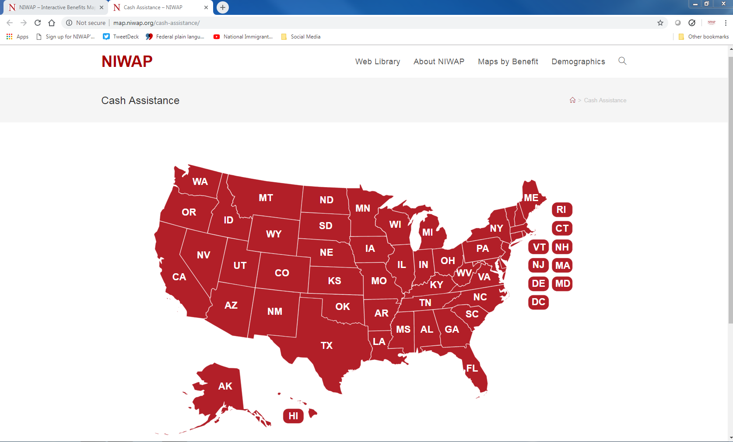

Slide 54
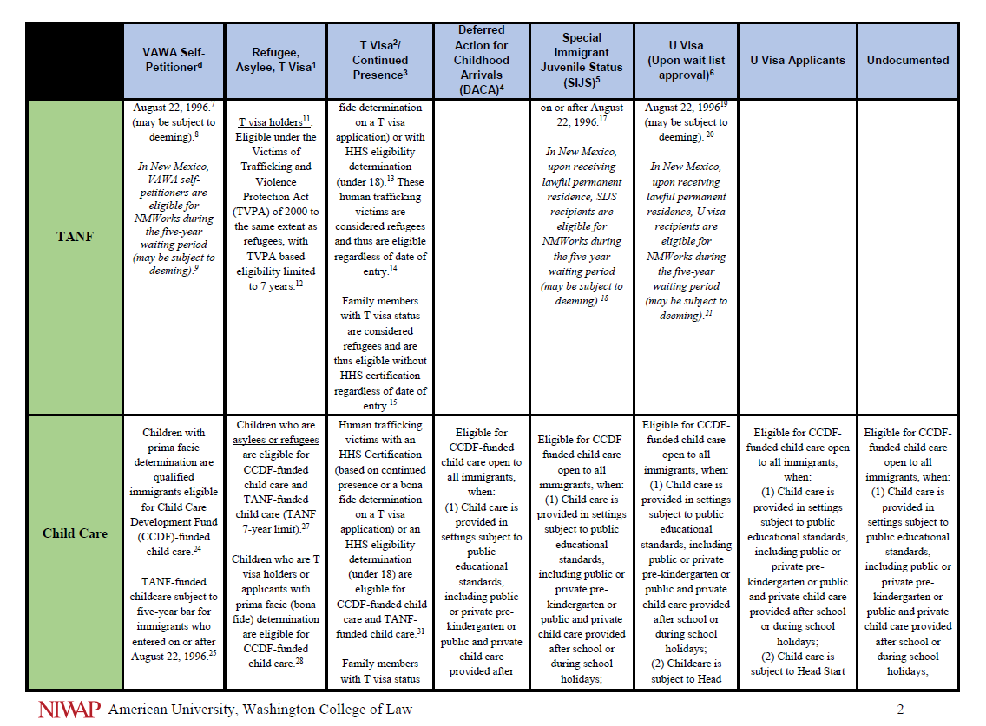

Slide 55
Immigrant Victims and Family Court Cases
55
Notes:
LY

Slide 56
Protecting Immigrant Mothers Protects Children
Immigrant victims who receive help, including immigration relief, child abuse likelihood drops significantly (77% to 23%).
Children of help seekers 20% less likely to have abuser threaten them
One third less likely to have abuser threaten to take them away from their mother
  Ammar, Orloff, Hass and Dutton, “Children of Battered Immigrant Women: An Assessment of the Cumulative Effects of Violence, Access to Services and Immigrant Status.” (September 2004) http://niwaplibrary.wcl.american.edu/pubs/co-occurencedvchildabuse/

Slide 57
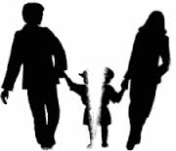
Is Immigration Status Relevant to Custody?
Relevant to: Immigrant crime victim presents evidence of immigration related abuse, power and control suffered
  Either not filing or withdrawing immigration papers
  Threats to turn victim in for deportation
  Part of history of violence
Not relevant to:
  Core primary caretaker determination
  Evaluation of parenting skills
  Best interests of the child determination
  Requirements regarding custody awards to non-abusive parent
Notes:
RG

Slide 58
Myth vs. Fact:
Parents without Legal Immigration Status
Myth
Fact
Deportation is imminent
Parent is likely to flee U.S. with child
The parent has no livelihood
Legally present parent must have custody in order to file for benefits for child
DHS policies prevent detention/removal of immigrant parents who are crime victims
US citizens and lawful permanent residents are more likely to flee with children, especially when
  There have been threats of kidnapping children
  They are dual nationals
  They travel freely to and from U.S.
Abused immigrant parents in family court have a path to immigration relief, work authorization & some benefits
Custody does not affect parent’s ability to file for or gain immigration benefits for his children.
Notes:
LY

Slide 59
Immigrant victims involved in custody cases will qualify for one or more of the following:
Domestic violence/child abuse= VAWA self-petitioning, VAWA defenses against removal in immigration court, Battered spouse waiver, Special Immigrant Juvenile Status
U visa = Domestic violence, sexual assault, stalking, human trafficking, other U visa crimes
T visa and continued presence = human trafficking cases both sex and labor trafficking

Slide 60
ICE Removal Data
2013
2017
Convicted criminals 82%
Repeat immigration violators 7.8%
Ordered removed and failed to depart 1.6%
Other immigrants 7.7%
https://www.ice.gov/doclib/about/offices/ero/pdf/2013-ice-immigration-removals.pdf
Criminal convictions 73.7%
Pending criminal charges 15.5%
Outstanding notices to appear in immigration court 5.3%
Ordered removed and failed to depart + reinstatement 2.8%
Other immigrants 2.6%
https://www.ice.gov/removal-statistics/2017

Slide 61
Victim Witness DHS Memo 2011 Continuing Effect Confirmed 4/19
Goal: “Minimize any effect that immigration enforcement may have on the willingness and ability of victims, witnesses, and plaintiffs to call police and pursue justice.”
“Absent special circumstances or aggravating factors, it is against ICE policy to initiate removal proceedings against an individual known to be the immediate victim or witness to a crime.”
Crime victims and witnesses should receive “release from detention and deferral or a stay of removal.”

Slide 62
Protection Orders
All persons are eligible to receive civil protection orders without regard to the immigration status of any party or child
Protection order issuance = no effect on immigration status
A conviction or finding of violation of the “protection against abuse provisions” of a protection order is a deportable offense
Immigrant victims and their children often need creative protection order remedies using the state catch all provisions
Notes:
Loretta

Slide 63
Use Creative Remedies to…
Stop immigration related abuse
Protect victims still living with their abusers
Obtain documents the victim needs for an immigration case or for care of child
Deter parental kidnapping
Child/Spousal support
  Affidavit of support
Health insurance
Notes:
Loretta

Slide 64
Immigrant Parents and Child Custody
In re Interest of Angelica L., 277 Neb. 984 (2009)
Parents have a constitutional right to custody (absent unfitness)
Applies to all families without regard to:
  Undocumented immigration status
  Immigration detention
  Deportation
Overriding presumption that:
  Parent-child relationship is constitutionally protected
  In children’s best interest to stay with/be reunited with their parent(s)
Child’s best interests is most important
  A comparison of natural vs. adoptive parent’s cultures, countries or financial means is not to be made
Notes:
LY

Slide 65
Detained Parent Directive Aug. 2017
If parents are detained:
  Placement near family court when ongoing family court/child welfare cases
  Bring parents to family court to participate in cases involving children
    Alternate: video or teleconference participation
  Facilitate visitation when required by family/child welfare court order
  Help children travel with deported parent –obtain passports for children
Notes:
Leslye

Slide 66
Impact of Divorce
VAWA self-petitioners:
  Spouse must file within two years of final divorce
  Step-children must file before divorce
Ends legal immigration status for spouses and children of visa holders:
  Students, Work Visa Holders, Diplomats
Divorce cuts off access to lawful permanent residency for spouses and children of people seeking lawful permanent residency based on:
  Employment
  Asylum
  Family relationships
  Cancellation of removal
Notes:
VTT

Slide 67
Annulment Instead of Divorce
Annulment can lead to a marriage fraud finding that:
  Permanently bars approval of any visa petition
  Is a ground for deportation
  Can lead to an unfavorable exercise of discretion by an immigration judge not to grant immigration relief
Impacts
  Spousal support
  Property division
Notes:
VTT

Slide 68
Immigration and Family Courts Other Issues
Where spouse sponsored immigrant spouse for lawful permanent residency
  Affidavit of support enforced as contract in family or federal court
  Evidence of ability to pay support
Importance of court ordered child support paid through the court

Slide 69
U Visa Certification By Judges

Slide 70
U Visa for Immigrant Victims
A victim of qualifying criminal activity is eligible for a U Visa when:
  The criminal activity occurred in the U.S. or violated U.S. law;
  The victims possesses information about the crime;
  The victim has been, is being, or is likely to be helpful in the detection, investigation, prosecution, conviction or sentencing of the offense; and
  The victim has suffered substantial physical or mental abuse as a result of the victimization
Notes:
Leslye

Slide 71
U Visa Qualifying Criminal Activity
Domestic violence
Sexual assault
Rape
Incest
Prostitution
Torture
Felonious assault
Manslaughter
Murder
Female genital mutilation
Kidnapping
Abduction
Trafficking
Involuntary servitude
Slave trade
Being held hostage
Fraud Foreign Labor Contracting
Peonage
False Imprisonment
Blackmail
Extortion
Witness tampering
Obstruction of justice
Perjury
Stalking
Attempt, conspiracy or solicitation to commit any of these crimes any similar activity
Notes:
Leslye

Slide 72
U Visa Statistics
11/2011
% of U Visas | Criminal Activity
45.9% | Domestic Violence
30.4% | Rape, Sexual Assault, Incest, Human Trafficking
9.9% | Felonious Assault, Murder, Manslaughter
8.47% | Kidnapping, Being Held Hostage, Unlawful Criminal Restraint, Torture
5.3% | Blackmail, Extortion, Perjury, Obstruction of Justice, Attempts, Conspiracy, Solicitation
76.1% = Domestic Violence, Sexual Assault, Child/Elder Abuse, Human Trafficking

Slide 73
U/T Visa Certification: Who Can Certify?
Federal, state, and local
  Police, sheriffs, FBI, HSI, ATF…
  Prosecutors
  Judges, Magistrates, Commissioners, Judicial Referees, Masters, Alderman, ALJs, Surrogates, Chancellors
Departments of Labor (DOL) and the Equal Employment Opportunity Commission (EEOC)
Child and Elder Abuse investigators and agencies
Other government agencies
Judicial Training Network
73
Notes:
Leslye Anyone with delegated authority form and state, local, tribal or territorial court to deiced cases
OTHER = Any government agency that has the authority to detect, investigate, prosecute, convict or sentence based on facts related to criminal activities covered by the U or T visa

Slide 74
Why would victims seek U visa certification from state courts?
Using your clickers please check:
      Only justice system contact a custody, protection order, civil employment or child welfare case
      No language access to police when victim called for help
      Judge observed victim’s attendance and participation in criminal case
      All of the above

Slide 75
U Visa Regulations Definitions Although terms are used interchangeably
As a matter of law (U visa regulations)
  Helpfulness in the “investigation or prosecution” always means
    “Detection, investigation, prosecution, conviction, or sentencing”
  “Crime” always means
    “criminal activity”
“Criminal activity” chosen to offer early access to justice system protection
  Improving stability for crime victims

Slide 76
What Evidence of “Criminal Activities” and “Helpfulness” Could be Present in These Cases?
Family
  Civil Protection
  Custody
  Divorce
  Paternity
  Adoption
Juvenile
  Child Abuse, Neglect, or Termination of Parental Rights
  Delinquency
Criminal
Probate
  Elder / Dependent Adult Abuse
  Guardianship
  Conservatorship
Civil
  Employment
  Tort damages against a perpetrator

Slide 77
Criminal Case Examples:
Evidence of Helpfulness
Evidence in case that the victim:
  Called 911
  Participated in a criminal investigation
  Identified perpetrator at line up
  Testified before a grand jury or at trial
  Appearance in a case
  Attended criminal court hearings in the case
  Victim impact statement
  Testimony at sentencing
Notes:
Breall/ Livingston

Slide 78
Family/Civil Case Examples:
Evidence of Helpfulness
Filed and/ or appeared at hearing for full protection order
Plead and or testified about abuse or sexual assault in a court case (e.g. protection order, divorce, custody, small claims, housing, employment)
Evidence in case that victim called the police, made a police report, cooperated in a criminal or EEOC investigation
Serving the perpetrator with notice of a
  temporary protection order
  A case in which the pleadings contain allegations of facts that constitute domestic violence, sexual assault or other U visa criminal activities
Notes:
Breall/ Livingston

Slide 79
According to DHS, a U/T Visa Certification Tells USCIS Only 3 Things:
Certifier believes the applicant is a victim of a qualifying criminal activity
Victim had knowledge of the criminal activity
Victim was, is, or is likely to be helpful in the detection, investigation, prosecution, conviction or sentencing

Slide 80
Helpfulness Requirement Met Even When:
Victim reports a crime and there’s no further investigation or prosecution
Perpetrator absconds or is deported
Perpetrator is being prosecuted for a different crime
Victim is not needed as a witness
Victim is dead (indirect victim is applying)
Perpetrator is dead
The criminal case did not result in a guilty plea or conviction
Victim is applying for a civil protection order or custody but domestic violence is not being criminally prosecuted

Slide 81
What evidence of helpfulness might you include on the U visa certification form?
Using your clickers please check:
      The fact that Clara sought and you issued a protection order
      Testimony Clara provided at a contested hearing
      You learned in the CPO case that Clara spoke to police at the crime scene and gave information for the police report
      All of the above

Slide 82
U-visa Facts and Benefits
Only 10,000 U-visas can be granted annually
  Waitlist approval backlog 110,000 visas
The U-visa grants a temporary 4 year stay
Work authorization ( ≈ 28-48 months)
Limited state benefits
Lawful permanent residency after 3 years if
  Cooperation or not unreasonably refuse to cooperate
  + humanitarian need, family unity or public interest
U.S. citizenship after 5 years of lawful permanent residency + proof of good moral character

Slide 83
Special Immigrant Juvenile Status (SIJS)
Humanitarian immigration relief for unmarried children who cannot be reunified with one or both parents who
  abused, abandoned or neglected the child
State court findings are required as evidence
  The court using state best interests laws makes as child custody or placement decision and includes SIJS findings
  The state court order does not provide immigration status
  The order is one required piece of evidence in a federal adjudication process

Slide 84
Why Congress Wanted Input From
State Court Judges
Included a role for state court judges as experts in child best interests, custody, and child welfare matters.
State court expertise that are an inherent part of court’s decision-making when courts:
  Adjudicate facts of child abuse, neglect and abandonment
  Issue orders regarding child care, custody, and placement that further the best interests of children

Slide 85
State Court Findings Needed for SIJS
*State Law Applies To Each*
The court has jurisdiction to issue orders regarding the care, custody, or placement of an immigrant child (under age of majority and unmarried) with
  An individual (e.g. non-abusive parent, grandparent, kinship care, guardian, next friend, adopting parent) OR
  State agency, private agency, including foster care system
It is not in the child’s best interest to return to their home country
  Best caregiver identification/often not necessary to compare countries
Reunification of the child is not viable with a parent due to at least ONE PARENT’S abuse, abandonment, or neglect

Slide 86
State Courts Regularly Make
Custody & Placement Determinations
Who will be the custodian/guardian of the minor
With whom will the child live
Whether the minor will be committed to the custody of the state or private agency for care, treatment, or rehabilitation

Slide 87
Department of Homeland Security Confirms
A juvenile court according to DHS
  The “title and the type of court that may meet the definition of a juvenile court will vary from state to state. Examples of state courts that may meet this definition include: juvenile, family, dependency, orphans, guardianship, probate, and delinquency courts.”
  “Juveniles” = all children

Slide 88
Decisions about care and custody of children arise in family court proceedings
Civil protection order cases
Custody cases
Divorce cases
Paternity and child support cases
Adoption cases
Motions for declaratory judgements
Bench Book chapters on each case type

Slide 89
Home country not in child’s best interests
Identify each potential custodian in U.S. and home country
Apply state best interests factors to each placement
States in court order the factual findings that support chosen placement
Make findings that illustrate why under state best interest factors court is not choosing placements in child’s home country
Compare the supports, help, services child needs U.S vs. home country
  Example of factors VAWA Extreme hardship

Slide 90
Reunification Not Viable and Best Interests
Order must include the finding that reunification with the parent is not viable
Using state best interests law
  Identify factual reasons why reunification is not viable
  Will include explaining why the abusive parent is not being granted physical custody of the child

Slide 91
Finding: Reunification Not Viable
Does not require termination of parental rights
Viability of reunification does not necessitate no contact with parent – Visitation can occur
Means granting the abusive parent custody is not envisioned by the court as a viable option
Changes in circumstances can occur
  But not granting full legal/physical custody to abusive parent
Notes:
Explicitly allows kids who got SIJS when in foster care or other placements to leave for custody or guardianship elsewhere without losing access to SIJS

Slide 92
Apply Same Jurisdiction and Procedural Rules as All Other Cases
Include a statement of the court’s jurisdiction citing the state statute, court rule, or other authority under which the court is exercising jurisdiction.
Follow your state court procedures and note that you do so to demonstrate that the court made an informed decision.

Slide 93
In the Clara and Eduardo Scenario in which of the following cases could the court NOT issue SIJS findings for Lupe as part of the court’s order?
Using your clickers please check:
      A protection order case in which the order grants Clara custody
      A custody case brought by Clara
      The criminal prosecution of Eduardo
      A child welfare case in which the court made findings of Eduardo’s abuse and placed the children with Clara

Slide 94
SJI Funded Resources: Menu of Topics
Victim protection based forms of immigration relief: (VAWA, U and T Visas, SIJS)
VAWA confidentiality limitations on courthouse immigration enforcement and state court discovery (family, civil, criminal)
Using legally correct information to address immigration allegations in custody, divorce, protection order, child/spousal support & child welfare cases
U and T Visa certification by state court judges
Special Immigrant Juvenile Status findings best practices
Public benefits access for immigrant victims
  Health care, housing, TANF, SNAP, Education and more
Improving access to justice for immigrant and LEP persons

Slide 95
Technical Assistance and Materials
Power Point presentations and materials for this conference at http://niwaplibrary.wcl.american.edu/FLFCC-2019/
Judicial Training Manual at http://niwaplibrary.wcl.american.edu/sji-jtn-materials/
  NIWAP Technical Assistance
  Call (202) 274-4457
  E-mail info@niwap.org
Web Library: www.niwaplibrary.wcl.american.edu
Notes:
Leslye

