Slide 1
For Judges, Court and Supervised Visitation Center Staff, Attorneys and Victim Advocates
Improving Access to Justice for Immigrant Survivors of Domestic Violence, Sexual Assault, Stalking, and Human Trafficking
Center for Justice Innovation, New York
August 8, 2024
National Immigrant Women's Advocacy Project
American University Washington College of Law

Slide 2
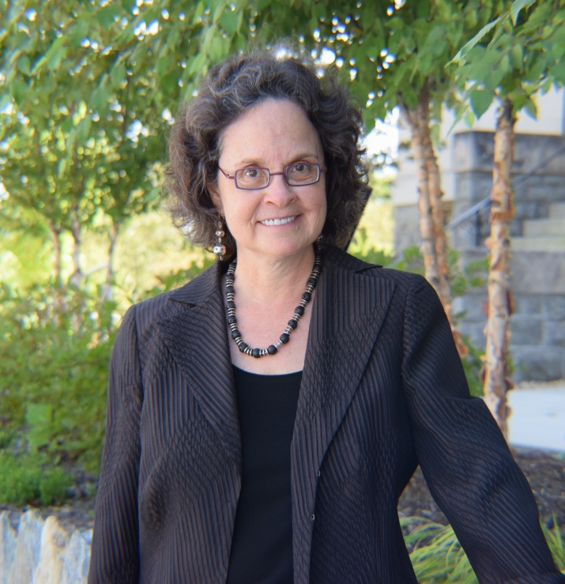
Leslye Orloff
Adjunct Professor and Director
National Immigrant Women’s Advocacy Project,
American University Washington College of Law

Slide 3
This project was supported by Grant Nos. 15JOVW-23-GK-05119-MUMU and 15JOVW-22-GK-04034-JFFX awarded by the Office on Violence Against Women, U.S. Department of Justice. The opinions, findings, conclusions, and recommendations expressed in this program are those of the author(s) and do not necessarily reflect the views of the Department of Justice, Office on Violence Against Women.
National Immigrant Women's Advocacy Project
American University Washington College of Law

Slide 4
NIWAP Resources
NIWAP Web library
Directory
Public Benefits Interactive Map & Demographics
Materials: Bench cards, toolkits, training tools, legal research, multi-lingual outreach materials
Technical Assistance
Cases, policies, strategies
Email, phone, zoom
Trainings and Webinars
On-line, virtual, in-person
Customized
Communities of Practice
Victim advocates, family lawyers, National Judicial Network
Law enforcement/prosecutors
National Immigrant Women's Advocacy Project American University Washington College of Law

Slide 5
NIWAP http://niwaplibrary.wcl.american.edu
Training Materials for:
Law Enforcement
Prosecutors
Systems Based Victim Advocates
Judges
Attorneys/Victim Advocates
Statutes, Regulations, Policies & Government Publications
Language Access
Multilingual Materials
Immigration
Family and Criminal Law
VAWA Confidentiality
Public Benefits, Legal Services & Economic Relief
Dynamics, Culture, Collaboration & Safety
National Immigrant Women's Advocacy Project
American University Washington College of Law

Slide 6
Join a NIWAP Community of Practice
Family Law Attorneys COP www.surveymonkey.com/r/FamCOP2023
Victim Advocates COP https://www.surveymonkey.com/r/VictimAdvocateCOPApp
Roundtable for Law Enforcement, Prosecutors and System-based Advocates https://www.surveymonkey.com/r/LERoundtable
National Judicial Network: Forum on Human Trafficking and Immigrants in State Courts (Judicial Officials only) https://niwaplibrary.wcl.american.edu/pubs/njn-outreach-letter

Slide 7
Learning Objectives
By the end of this webinar, participants will be better able to
Identify survivors eligible for VAWA and other victim-based immigration protections
Respond to issues commonly raised by perpetrators of domestic and sexual violence in protection order, custody, child support and divorce cases
Help immigrant and limited English proficient victims obtain custody of their children and creative family court remedies that promote victim safety

Slide 8
Immigration Relief Overview and Screening

Slide 9
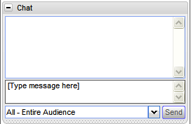
How do VAWA’s immigration protections benefits immigrant victims and their children?

Slide 10
Benefits for Survivors
Protection from deportation
Access to legal immigration status
Financial independence from the perpetrator
Legal work authorization (6 months to 2 years from filing)
Issuance of federally recognized driver’s licenses and IDs
Increased access to federal and state public benefits
VAWA confidentiality

Slide 11
Immigration Protections for Noncitizen Victims of Crime and Abuse
Notes:
DHS Shield: shield - https://www.dhs.gov/sites/default/files/2021-11/U.S.%20Immigration%20Benefits%20for%20Noncitizen%20Crime%20Victims.pdf

Slide 12
Qualifying Criminal Activity
Abduction | Hostage | Sexual Assault
Abusive Sexual Contact | Incest | Sexual Exploitation
Blackmail | Involuntary Servitude | Slave Trade
Domestic Violence | Kidnapping | Stalking
Extortion | Manslaughter | Torture
False Imprisonment | Murder | Trafficking
Felonious Assault | Obstruction of Justice | Witness Tampering
Female Genital Mutilation | Peonage | Unlawful Criminal Restraint
Fraud in Foreign Labor Contracting | Perjury | Prostitution
Rape | Attempt, conspiracy or solicitation to commit crime or similar activity
Notes:
Discuss examples of similar including hate crimes, elder abuse and child abuse

Slide 13
Similar Criminal Activity
Qualifying criminal activity includes any similar activity where the elements of the crime are substantially similar. Examples:
Hate crimes
Video voyeurism
Elder abuse/abuse of adults with disabilities
Child abuse
Robbery or aggravated robbery could include felonious assault, depending on the evidence and state law definition
National Immigrant Women's Advocacy Project
American University Washington College of Law

Slide 14
VAWA Self-Petitioning Requirements
Subjected to Battery or Extreme Cruelty
By a U.S. Citizen or Permanent Resident
spouse; parent; or citizen adult son/daughter (over 21)
With whom Self-Petitioner Resided
No time period required
Good Moral Character
Good Faith Marriage
VAWA cancellation of removal has similar eligibility requirements
2023 time to work authorization = 4-34 months
National Immigrant Women's Advocacy Project
American University Washington College of Law
Notes:
Extreme Cruelty: Intimidation, Social Isolation Humiliation, insults, Possessiveness, stalking
Harm to pets, Minimizing, Denying & Blaming, Emotional Abuse, Economic Abuse, Coercion , Threats of deportation

Slide 15
Battered Spouse Waivers
For domestic violence survivors, provides for waiver of the “condition” placed on the status of immigrant spouses of marriages less than two years old
Waives both the joint filing requirement and two year wait for full lawful permanent resident status
Requires proof that:
Marriage to a U.S. citizen or permanent resident entered into in good faith and
Spouse or child was battered or subjected to extreme cruelty
Child can include step-child
Immigration and Nationality Act § 216(c)(4)
2023 time to approval 17.5 to 29 months
National Immigrant Women's Advocacy Project
American University Washington College of Law

Slide 16
Special Immigrant Juvenile Status (SIJS)
Immigration relief for unmarried children
Under the age of majority under state law
Victims of abuse, abandonment, neglect, or dependency
By at least one parent
To apply must submit the required findings from a state court with jurisdiction over
the care, custody, or dependency of the child
2023 time to work authorization = 6 months
National Immigrant Women's Advocacy Project
American University Washington College of Law

Slide 17
U Visa Requirements
Victim of a qualifying criminal activity
Has been, is being, or is likely to be helpful in
Detection, investigation, prosecution, conviction or sentencing
Suffered substantial physical or mental abuse as a result of the victimization
Possesses information about the crime
Crime occurred in the U.S. or violated U.S. law
2023 time to work authorization – 60-62 months
17
National Immigrant Women's Advocacy Project
American University Washington College of Law
17

Slide 18
T Visa for Trafficking Victims
A victim of a severe form of trafficking in persons
Sex or labor trafficking involving victim under 18 or and adult subject to force, fraud or coercion
Victim is physically present in the U.D. on account of trafficking
Victim must comply with reasonable requests for helpfulness in investigating or prosecuting trafficking. Exceptions
Under age 18
Physical or psychological trauma impedes helpfulness/cooperation
Removal from the U.S. would cause extreme hardship
2023 time to work authorization = 18 months
National Immigrant Women's Advocacy Project
American University Washington College of Law

Slide 19
Clara and Eduardo Case Scenario
Clara met Eduardo a lawful permanent resident when he came back to his hometown to visit his family in El Salvador. Eduardo started dating, Clara who was raising her 9 year old son Miguel. After Clara became pregnant and gave birth to a baby girl Lupe, Eduardo decided to bring Clara, Miguel and Lupe to the U.S. to live with him. When they arrived in the U.S. Eduardo took Clara, Miguel and Lupe’s passports and became physically and sexually abusive of Clara and abusive of Miguel who tried to protect his mother from Eduardo’s abuse. Eduardo also physically beat Lupe when he said she “misbehaved”. Within a year following their arrival in the U.S. Eduardo forced both Clara and Miguel to work for his family’s business and never paid them for their labor. One night when Miguel was 13 and Lupe was 5, Eduardo’s rage led to severe beatings with a belt of Miguel and of Lupe. When Clara intervened to protect the children, Eduardo strangled her until she passed out. The neighbors call the police for help, Clara talked to police when they arrived. The police arrested Eduardo for attempted murder and child abuse, took Clara to the hospital and placed the children in the care of the state.
National Immigrant Women's Advocacy Project
American University Washington College of Law

Slide 20
What forms of immigration relief would Clara qualify for: (Check all that apply)
U visa
Included in Lupe’s VAWA self-petition
T visa
Filing her own self-petition
National Immigrant Women's Advocacy Project
American University Washington College of Law
Notes:
Answer: All of the above

Slide 21
What forms of immigration relief would Lupe NOT qualify for: (Check all that apply)
VAWA self-petition
U visa
Special Immigrant Juvenile Status (SIJS)
T visa
National Immigrant Women's Advocacy Project
American University Washington College of Law
Notes:
Correct answer is D.
Lupe can self-petition and include her mother (but not her brother in her application)
Lupe qualifies for a U visa
Lupe qualifies for SIJS because the abuser was her father but she cannot include Clara in her application or Miguel.

Slide 22
What forms of immigration relief would Miguel qualify for: (Check all that apply)
VAWA self-petition
U visa
T visa
SIJS
National Immigrant Women's Advocacy Project
American University Washington College of Law
Notes:
Correct answer is B and C Miguel is eligible for the U visa because of the abuse and T visa because of the forced labor
If Clara and Eduardo were married then Eduardo would also qualify for VAWA self-petition
If Miguel was abandoned by his natural father may qualify for SIJS

Slide 23
After VAWA Self-Petitioners and U Visa Victims Receive Work Authorization and Deferred Action
Increased justice system involvement
114% increase in willingness to trust the police
36% make police reports regarding future crimes
60% seek protection orders and/or custody
22% help other victims report abuse and seek help/justice
Significant reductions in abusers using the victim’s immigration status as a tool to perpetuate abuse
74% decline in immigration-related abuse
78% decline in threats to snatch/cut off access to children
65% decline in efforts to use the immigration status of the victim to gain an advantage in family court
National Immigrant Women's Advocacy Project
American University Washington College of Law
Notes:
Leslye E. Orloff, Haley Iesha Magwood, Yasmin Campos‐Mendez, and Giselle A. Hass, Transforming Lives: How the VAWA Self‐petition and U Visa Change the Lives of Victims and their Children After Work‐Authorization and Legal Immigration Status (April 2021) https://niwaplibrary.wcl.american.edu/pubs/exec‐summary‐transforming‐lives

Slide 24
Access for All
Both documented and undocumented immigrant survivors can access:
Legal Services
Family Court (Divorce)
Language Access
Police Assistance
Protection Orders
Child Custody & Support
Have Their Abusers Criminally Prosecuted
Public Benefits for Their Children
Assistance for Crime Victims
Shelter
Transitional Housing
GED
WIC/school lunch & breakfast
Primary/Secondary education
Immunizations
Emergency medical care
Care from community & migrant health clinics
VOCA
Notes:
APARNA

Slide 25
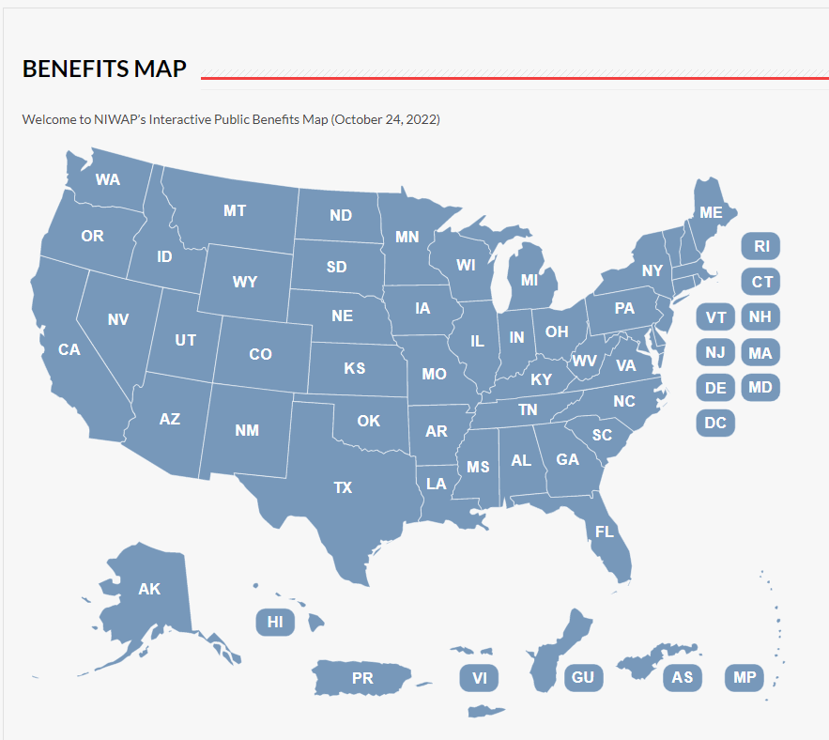
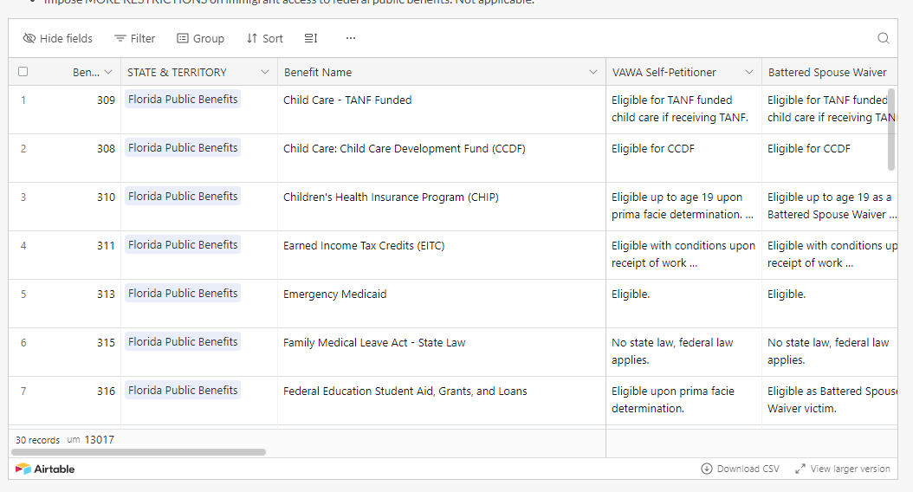
As Survivors Apply for Immigration Relief Benefits Access Increases Interactive Public Benefits Map: State-By-State
https://niwaplibrary.wcl.american.edu/benefits-map
Notes:
RAFAELA

Slide 26
Protection orders

Slide 27
True or False Issuance of a protection order is a deportable offense?
True
False
Notes:
Answer E

Slide 28
Immigrants and Protection Orders
All persons are eligible to receive civil protection orders without regard to the immigration status of any party or child
Protection order issuance = no effect on immigration status
Immigrant victims and their children often need creative protection order remedies using the state catch-all provisions

Slide 29
Which the following is a deportable offense?
Domestic violence criminal conviction
Finding in a custody case that a protection order was violated by further abuse of the victim
Criminal conviction for violating a protection order
Agreeing to diversion in a protection order enforcement case where upon violation diversion turns into a conviction
All of the above
Notes:
Answer E

Slide 30
Creative Protection Order Remedies
Catch all provisions in civil protection order statutes, opportunity to offer relief designed to help:
Curb future abuse, harassment
Interfere with abuser/perpetrator’s ability to exert power and/or coercive control
Offer victim remedy relief for past abuse
Help victim overcome victimization and build new post-abuse life
Nexus with victimization
Opportunity for courts to counter immigration-related abuse and order culturally helpful remedies

Slide 31
The Majority of Immigrant Victims Stay With Their Abusers …
Until the victim receives work authorization as part of their immigration case or their case is approved
Percent who leave before receiving work authorization or approval
VAWA self-petitioners 33.9%
U visa victims 30.1%

Slide 32
Victims Who Stay: No Unlawful Contact Protection Orders
No state’s protection order statute requires separation of the parties
Provisions:
No abuse
No unlawful contact
Batterer’s treatment

Slide 33
Use Creative Remedies to…
Stop immigration-related abuse
Protect victims still living with their abusers
Obtain documents the victim needs for an immigration case or for the care of a child
Deter parental kidnapping
Child/Spousal support
Affidavit of support
Health insurance

Slide 34
Helpful Evidence
Evidence of Legal Marriage
Marriage certificate
Wedding/family pictures
Health insurance
Good Faith Marriage
Children birth certificates
Love letters, cards, text, emails
Copies of joint leases/utility bills
School records
Letters and other mail addressed to the victim and to the abuser at the same address
Evidence of Abuse or Extreme Cruelty
Police, medical, court documents about the relationship
Protection order
Affidavits of neighbors, relatives, friends
Evidence of Abusers Legal Status
Abuser’s green card or passport
Copy of I-130 petition
Social security number

Slide 35
Custody of Children in Immigrant Families
Tool: Immigrant Victims and Custody Bench Card
35

Slide 36
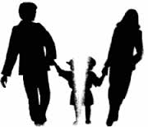
Is Immigration Status Relevant to Custody?
Relevant to: Immigrant crime victim presents evidence of immigration related abuse, power and control suffered
Either not filing or withdrawing immigration papers
Threats to turn victim in for deportation
Part of history of violence
Not relevant to:
Core primary caretaker determination
Evaluation of parenting skills
Best interests of the child determination
Requirements regarding custody awards to non-abusive parent

Slide 37
Myth vs. Fact: Parents without Legal Immigration Status
Myth
Fact
Deportation is imminent
The parent has no livelihood
Legally present parent must have custody in order to file for benefits for child
DHS policies prevent detention/removal of immigrant parents who are crime victims
Abused immigrant parents in family court have a path to immigration relief, work authorization & some benefits
Custody does not affect parent’s ability to file for or gain immigration benefits for his children.

Slide 38
Poll: Who is the least likely to flee with children from the United States?
U.S. citizens
Undocumented immigrant victim mothers
Dual national parents
Multiple entry visa holder parents
Notes:
Answer B

Slide 39
Fact: Legal immigrants/naturalized citizens are more likely to flee with children
Particularly when
There have been threats of kidnapping children
They are dual nationals
They can travel freely to and from U.S.
The Ninth Circuit found that “there is no evidence that undocumented status correlates closely with unmanageable flight risk.” Lopez-Valenzuela v. Apaio, 770 F.3d 772, 786 (9th Cir. 2014).

Slide 40
ICE Parental/Guardian Interests Directive Part I July 2022
Requires affirmative and ongoing inquiries about and identification of parents/legal guardians of minor children and incapacitated adults
Status as a caregiver parents/legal guardian impacts
Decision to detain, initial placements, transfers of parents
Rights to family visitation & child welfare services/programs
ICE to comply with and facilitate court ordered visitation
Notes:
L

Slide 41
Information About Protected Areas From Immigration Enforcement Can Help With Visitation Exchange
VAWA Confidentiality
DHS Policy 10/27/21 At or Near:
Victims protected at courthouses in connection with civil/family/criminal cases related to
Domestic violence, sexual assault, trafficking, stalking
Shelters, rape crisis centers
Supervised visitation centers
Family Justice Centers
Programs serving victims
Schools and universities
Medical or mental health care facilities
Places of worship, religious events, weddings, funerals
Places where children gather
Social services: e.g., crisis, domestic violence, child advocacy, food banks, victim services, shelters, supervised visitation, family justice centers…
Disaster/emergency response offered including family reunification
Ongoing parade, demonstration, rally
National Immigrant Women's Advocacy Project
American University Washington College of Law

Slide 42
Divorce and Economic Support

Slide 43
Impact of Divorce
VAWA self-petitioners:
Spouse must file within two years of final divorce
Step-children must file before divorce
Ends legal immigration status for spouses and children of visa holders:
Students, Work Visa Holders, Diplomats
Divorce cuts off access to lawful permanent residency for spouses and children of people seeking lawful permanent residency based on:
Employment
Asylum
Family relationships
Cancellation of removal

Slide 44
Annulment Instead of Divorce
Annulment can lead to a marriage fraud finding that:
Permanently bars approval of any visa petition
Is a ground for deportation
Can lead to an unfavorable exercise of discretion by an immigration judge not to grant immigration relief
Impacts
Spousal support
Property division

Slide 45
Affidavits of Support
Each person who petitions for a family member to immigrate to the United States must execute a legally enforceable affidavit of support. 8 U.S.C. § 1182(a)(4)(C)(ii)
Contractually committed to support sponsored family member at annually at 125% of Federal Poverty Guidelines
Affidavits of Support are enforceable as contracts by the sponsored immigrant
Support obligation lasts till immigrant spouse
Naturalizes, dies, earns 40 quarters of work credit, or gives up lawful permanent residency and leaves the U.S.

Slide 46
Immigration Issues Arising in Child Support Cases
There are immigration benefits for both parents to court ordered child support
Lack of legal work authorization is not a valid defense to non-payment of child support
Courts can impute income
Can order child support, but not a job search, of an undocumented non-custodial parent
Can order non-custodial parent to obtain an ITIN and pay taxes

Slide 47
Questions and Answers

Slide 48
Technical Assistance and Materials
Power Point presentations and materials for this webinar at https://niwaplibrary.wcl.american.edu/CJI-JFF Aug 2024/
NIWAP Technical Assistance
Call (202) 274-4457
E-mail info@niwap.org
Web Library: www.niwaplibrary.wcl.american.edu

Slide 49
Evaluation

